Slide 1
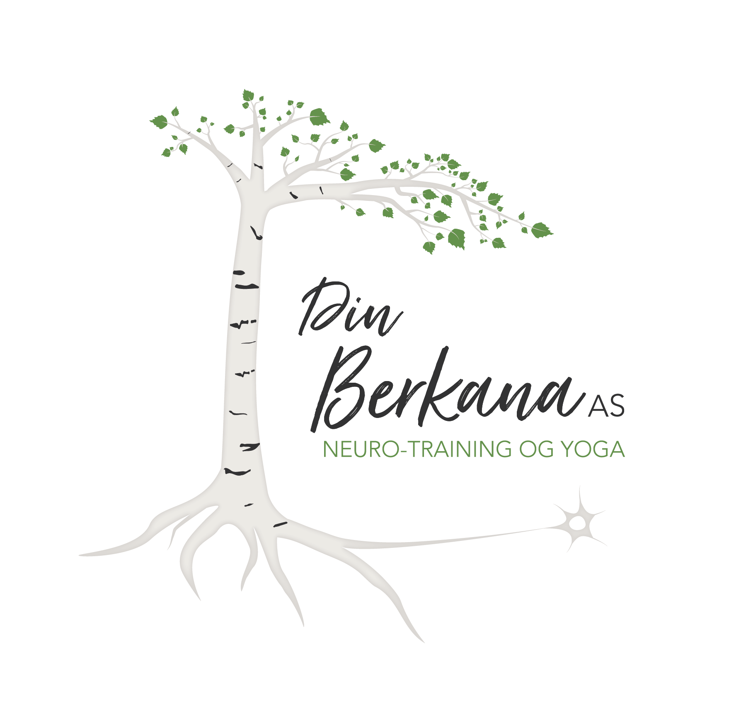
Yoga & kinesiology
How I include yoga in my kinesiology/neuro-training pracsis?

Slide 2
Who am I: Malene Osa-Bjørkmo
I have worked fulltime as a kinesiologist and yoga teacher since 2007, when I was 20 years old.
IKC National Trainer in Norway
Teach in College of Neuro-Training
Leader of the norwegian kinesiology assosiation (DNKF)
I run a kinesiology and neuro-training clinic in the south of Norway together with my mother
Din Berkana Yogastudio
Husbond, two kids and a dog

Slide 3
What is kinesiology?
Movement
Recuperation
Finding inner peace
Excess your recourses
Increase your potential
Prosess challenges

Slide 4
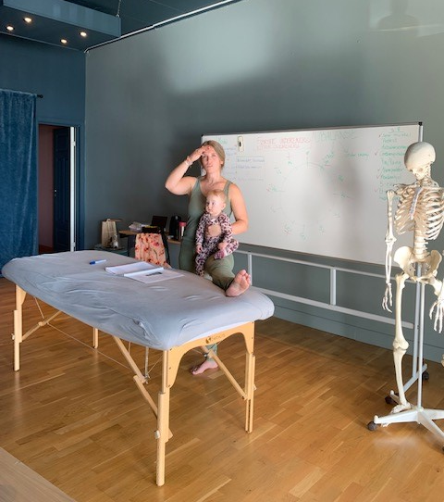
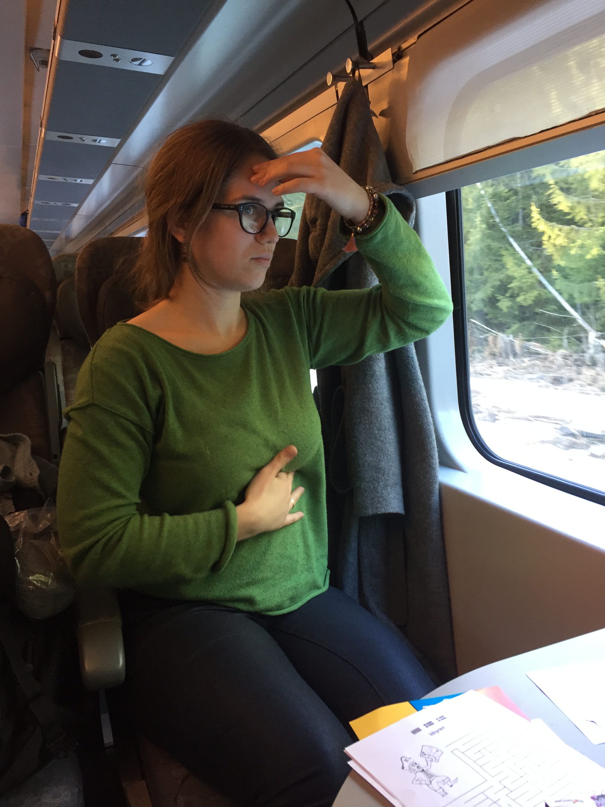
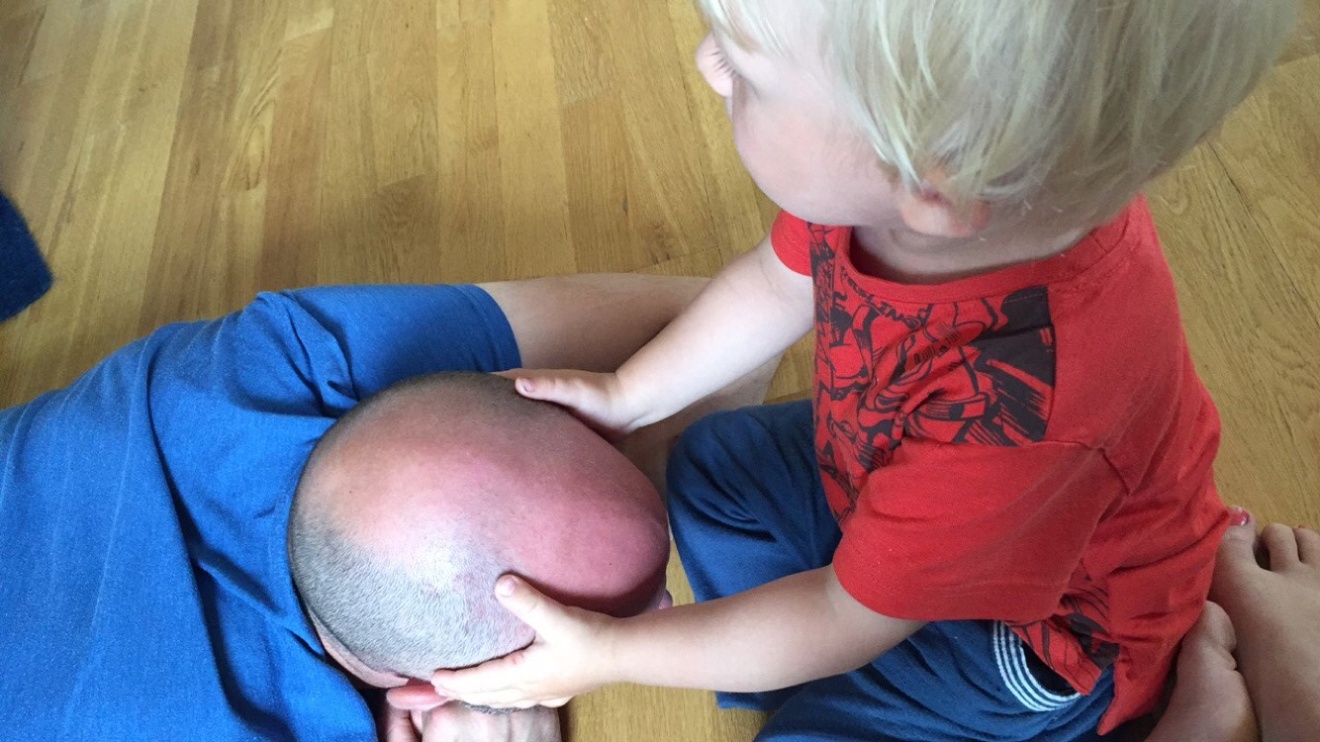
Kinesiology in my daily life:

Slide 5
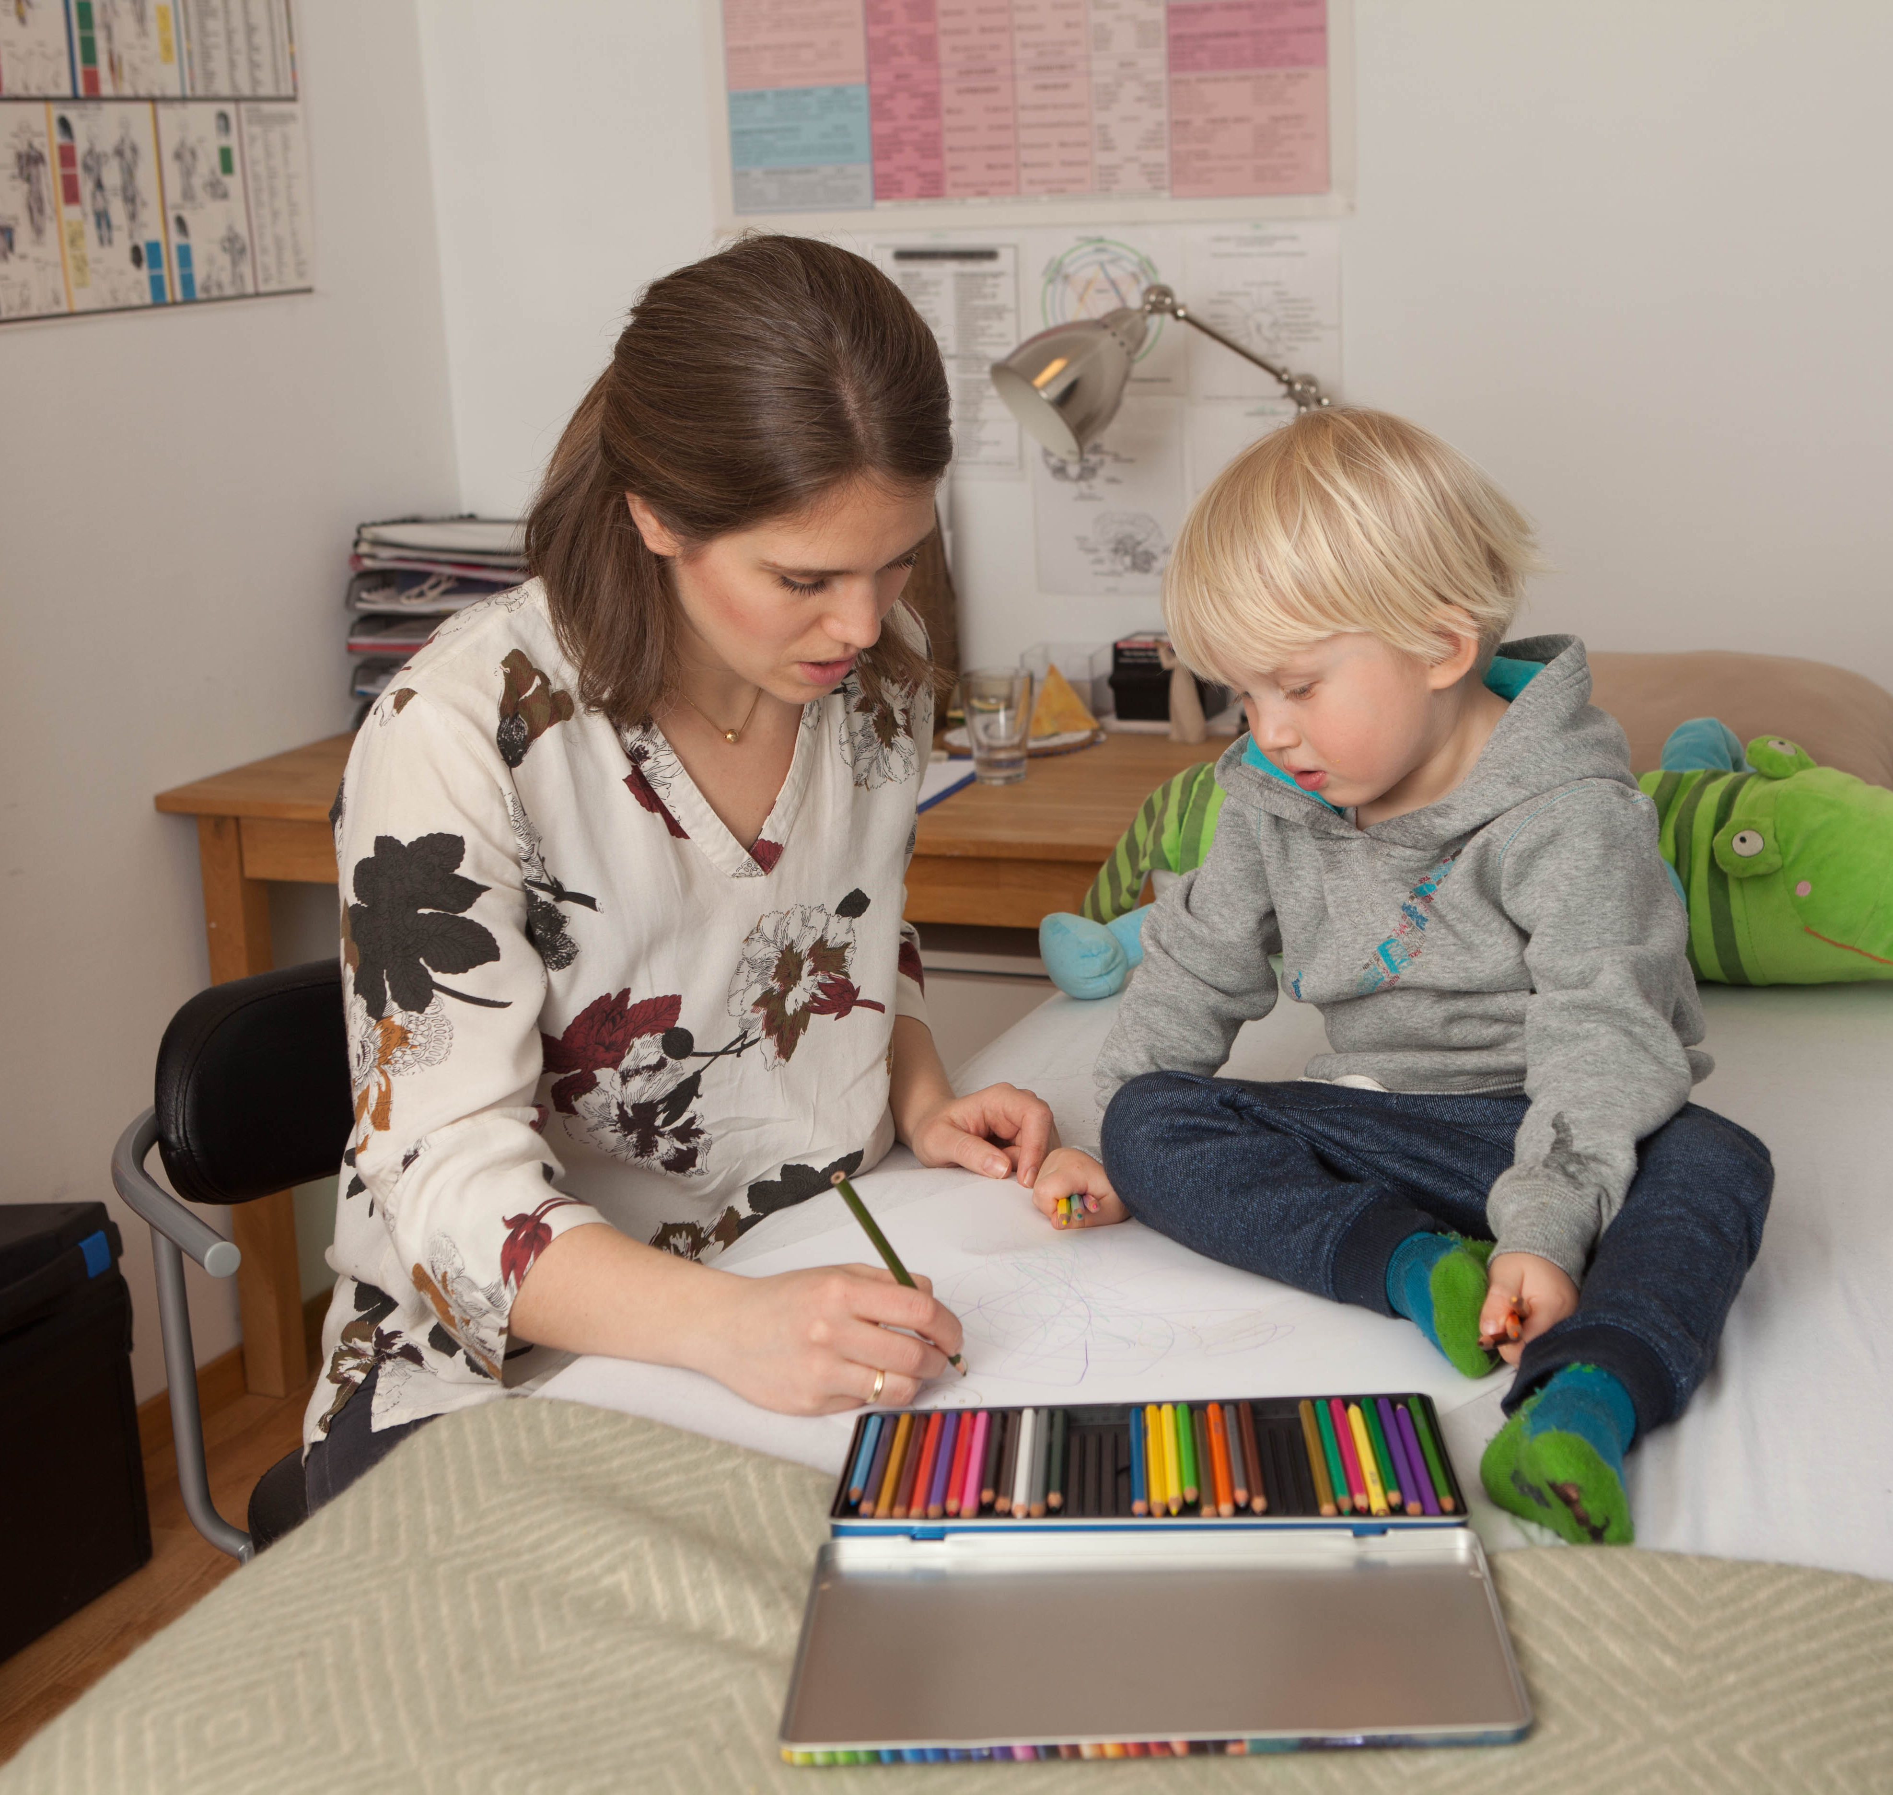
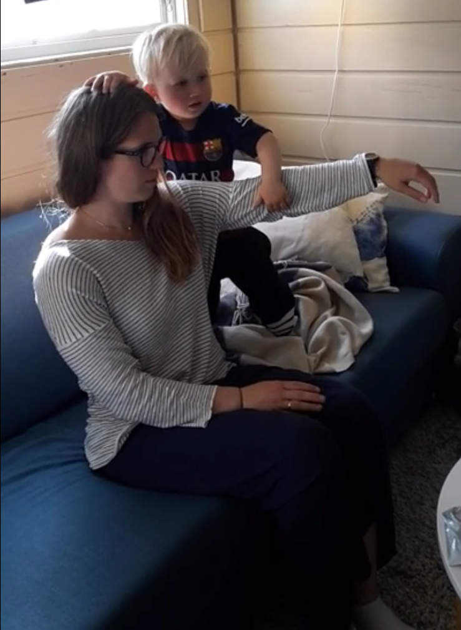
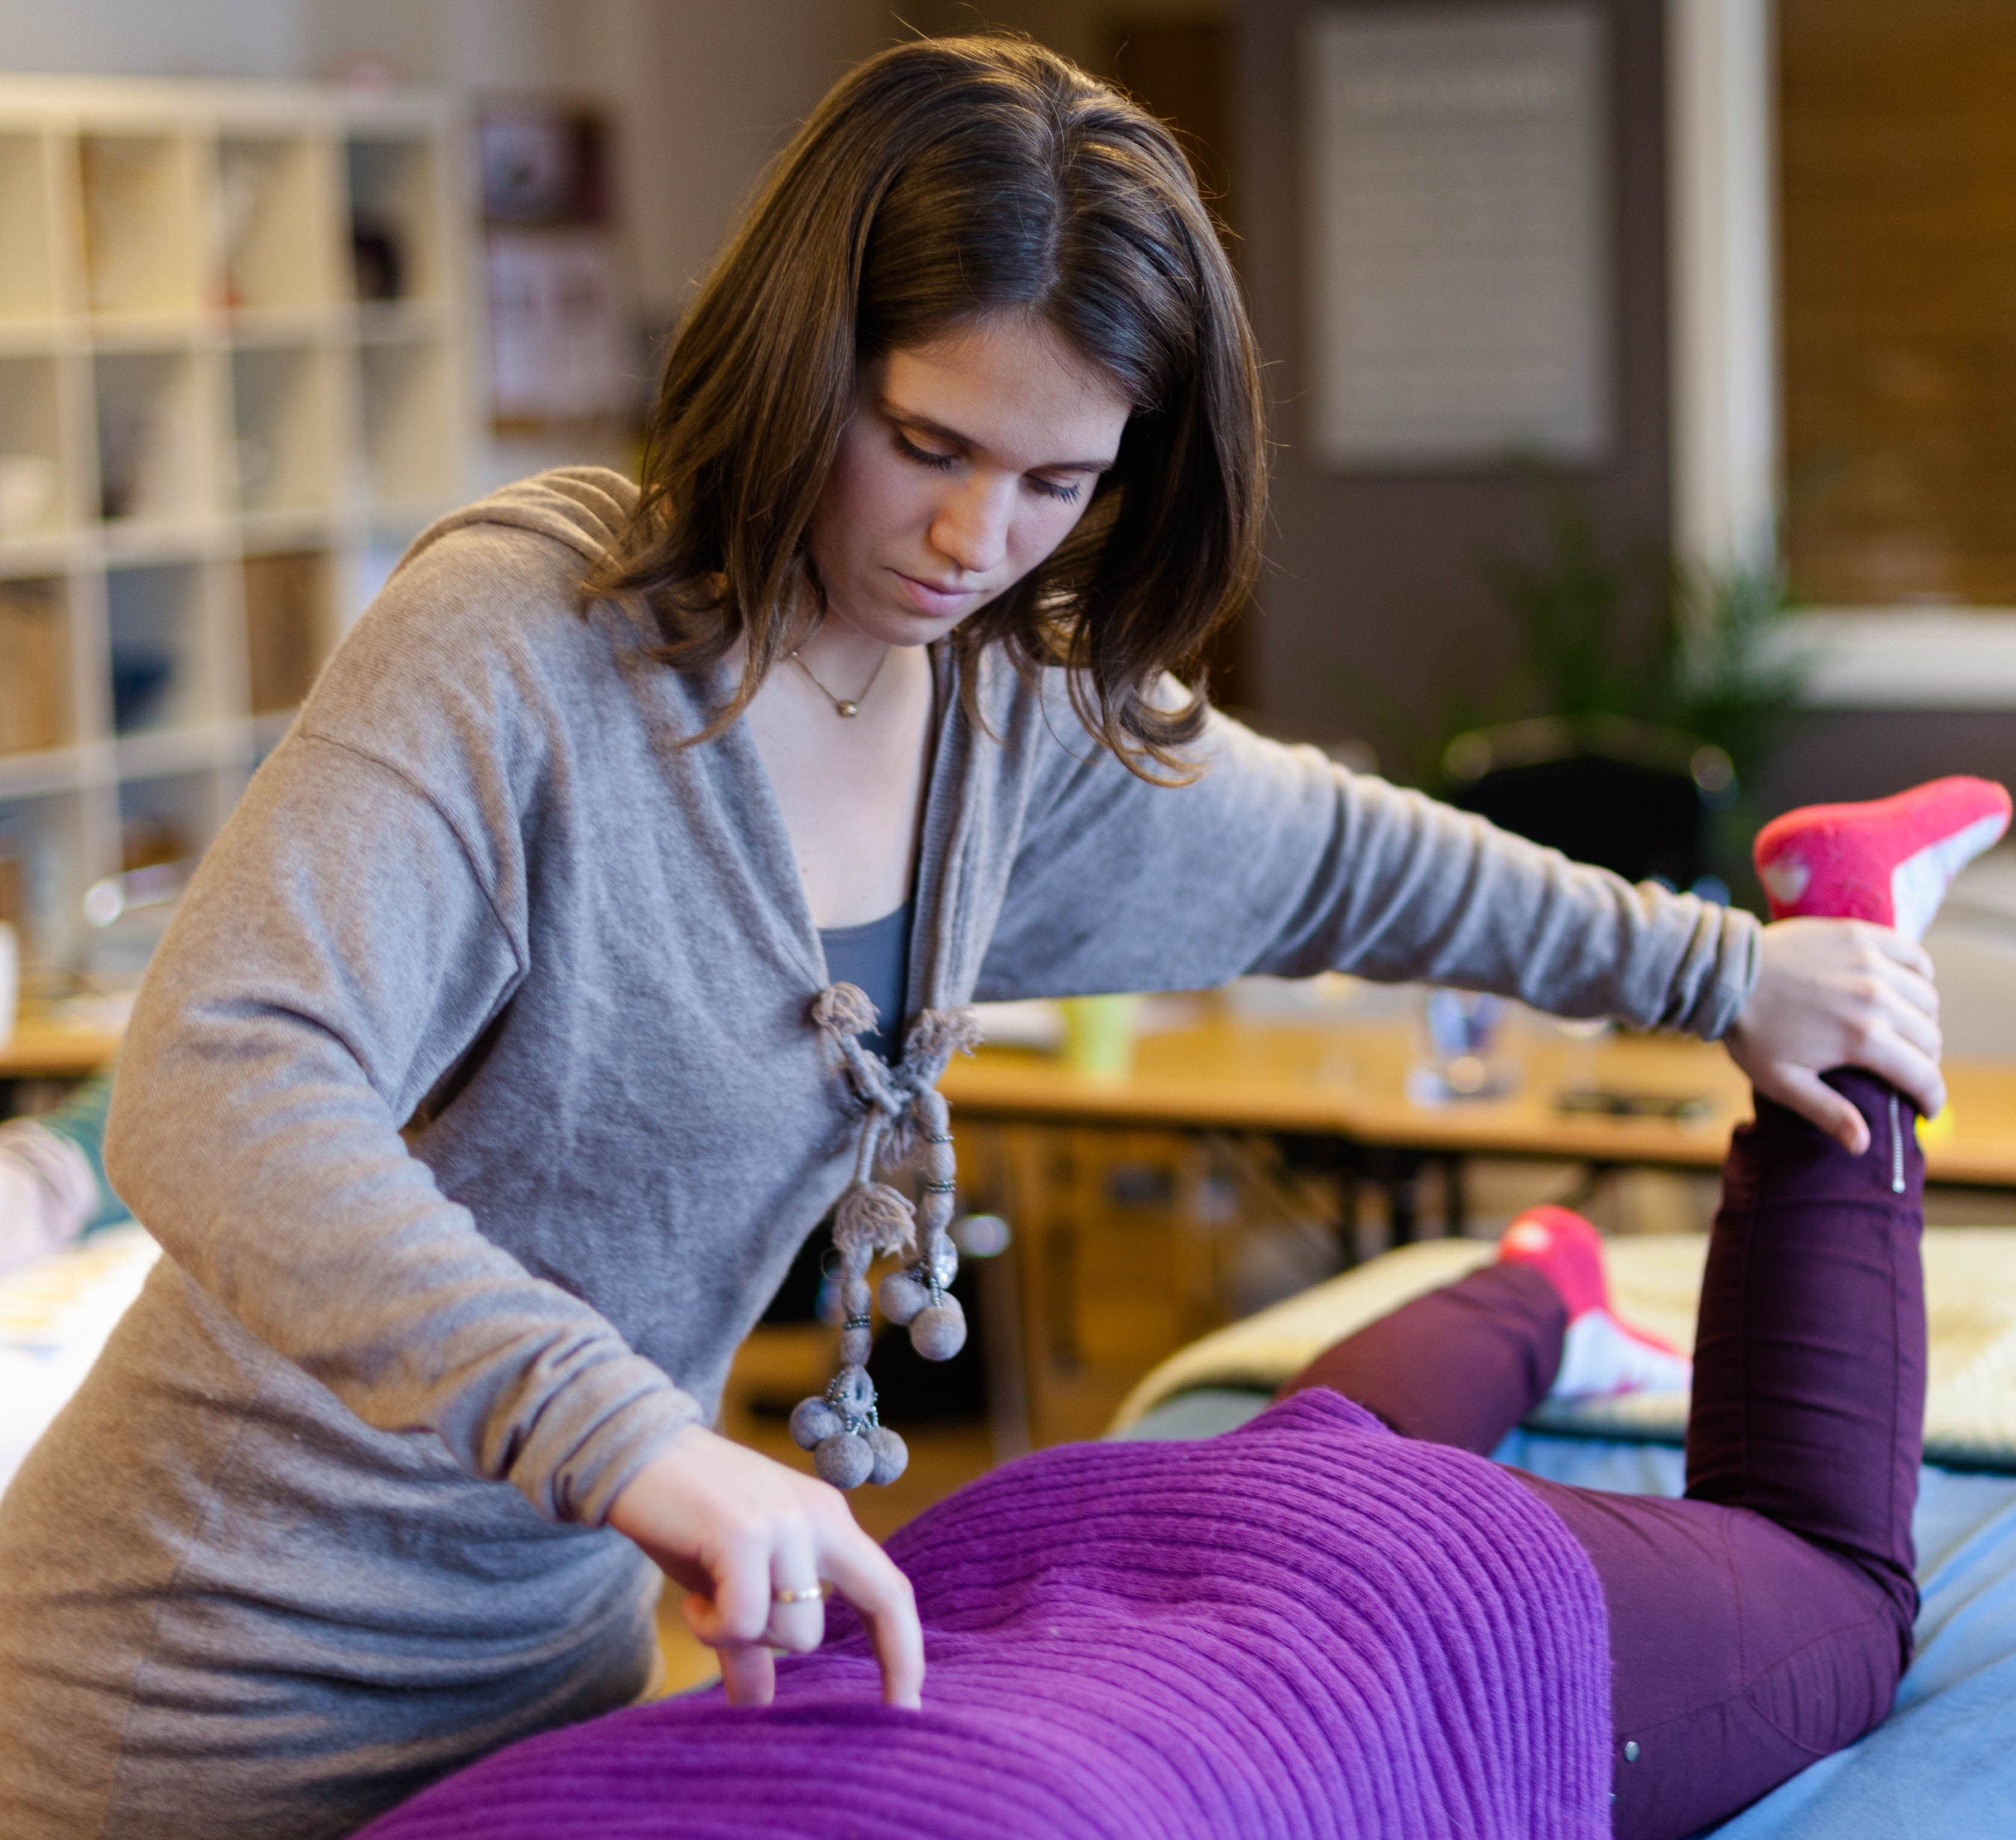
Kinesiology in my daily life:

Slide 6
What is yoga?
To find your self
Gather your energies and be present.
Find inner peace and security
Mental, emotional og fysical balance
Yoga is a practise, a way of living and thinking.

Slide 7
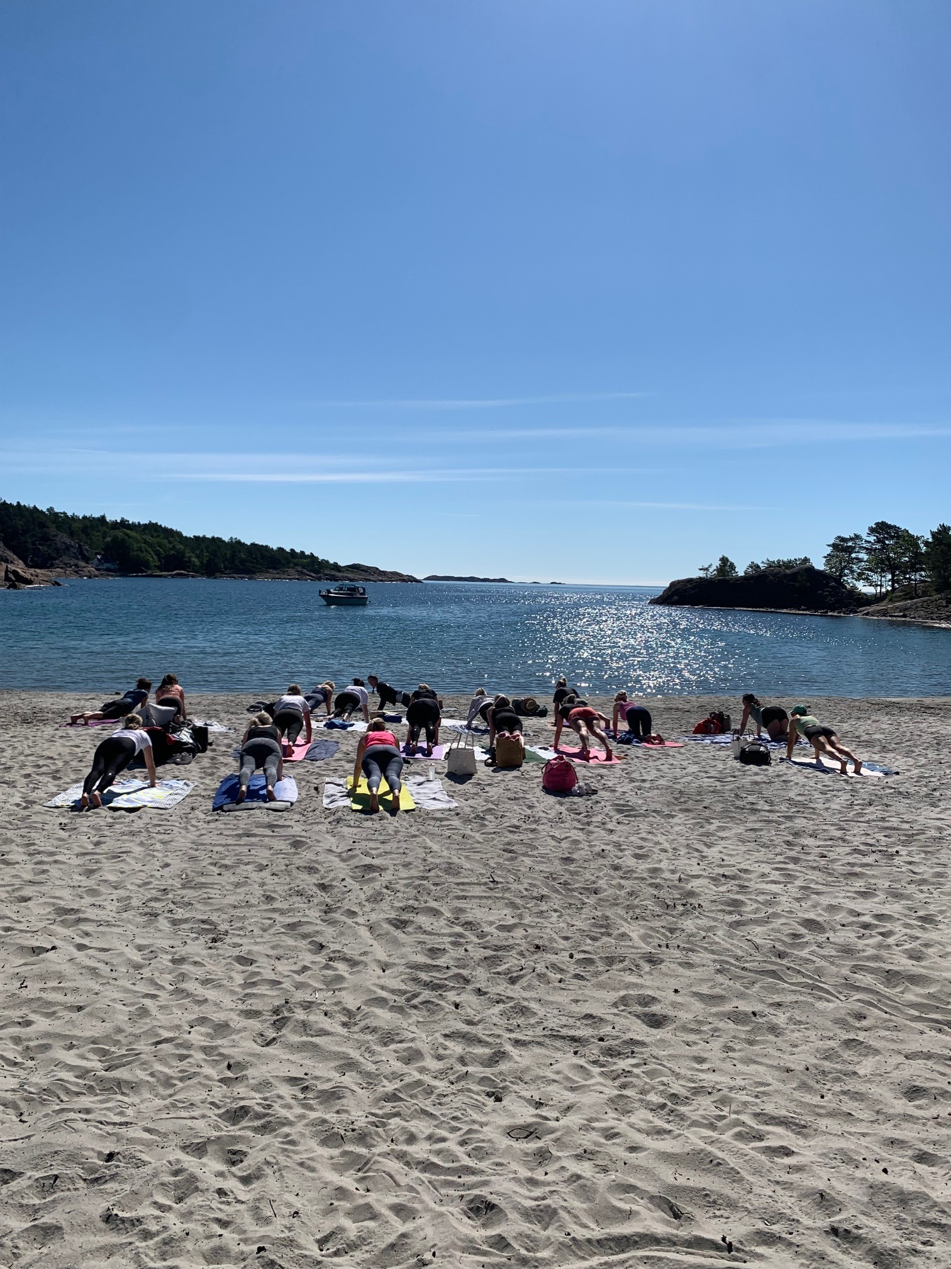
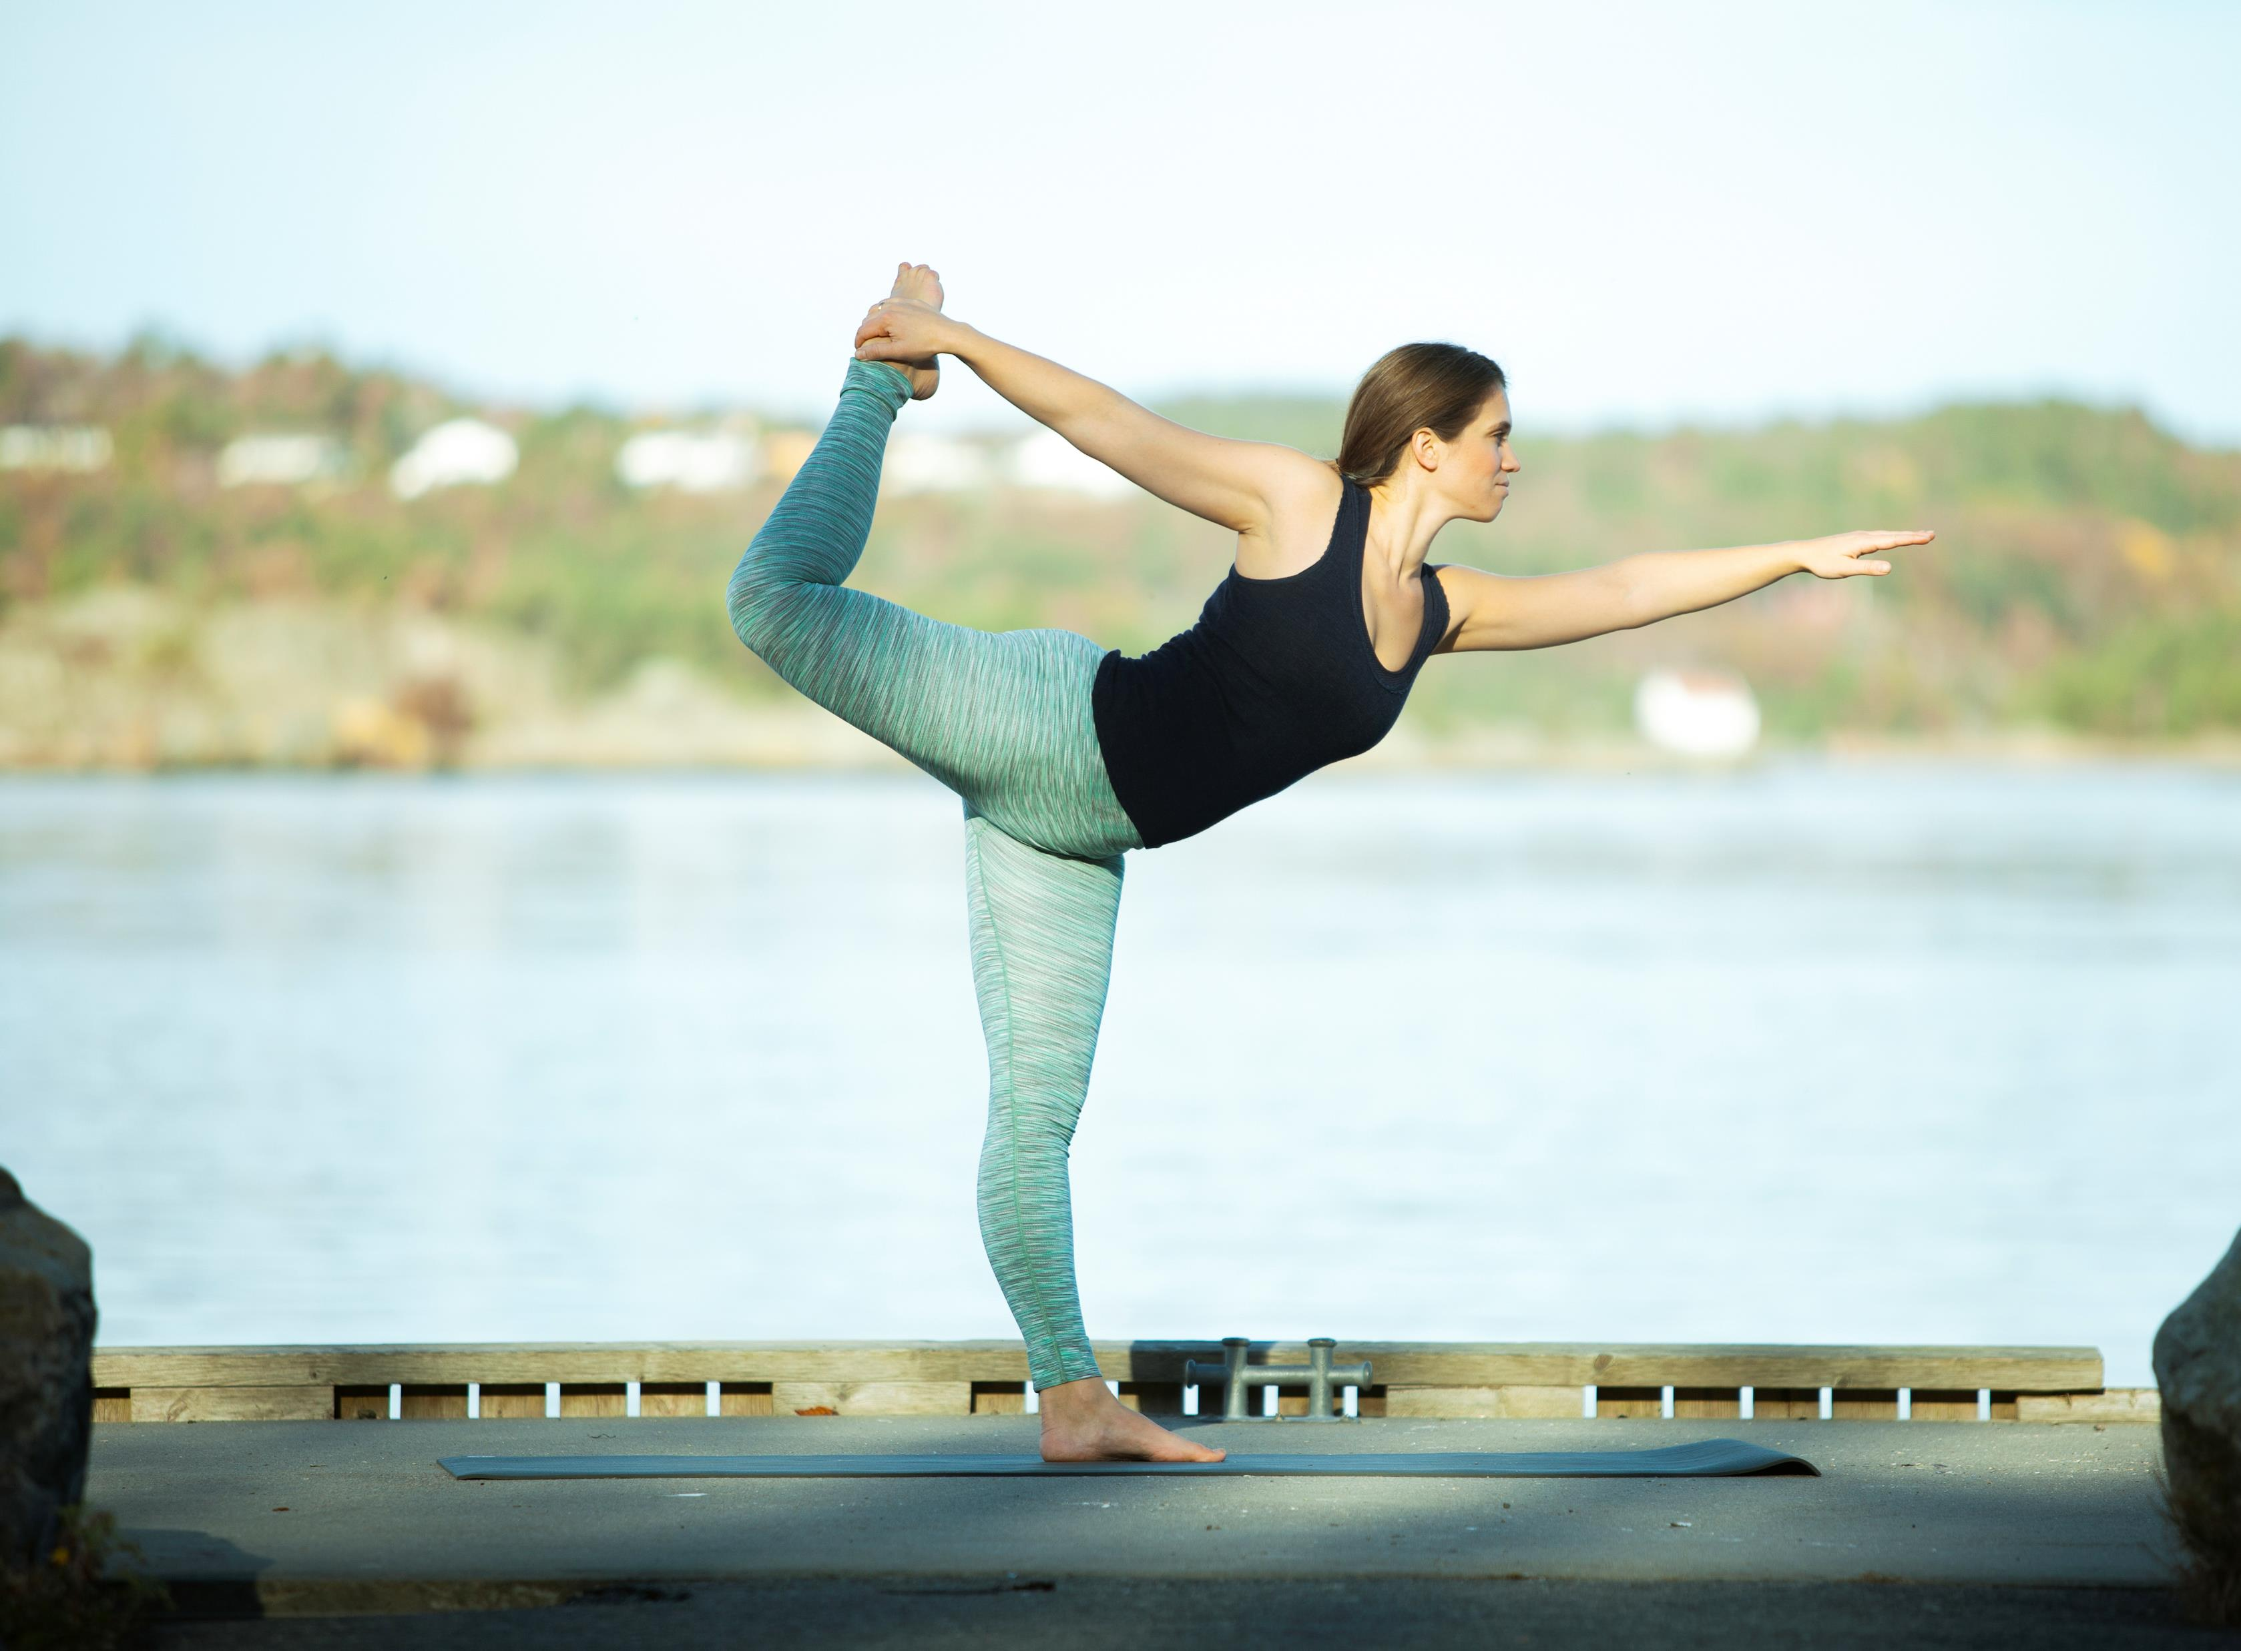
Asanas
(posture/place)

Slide 8
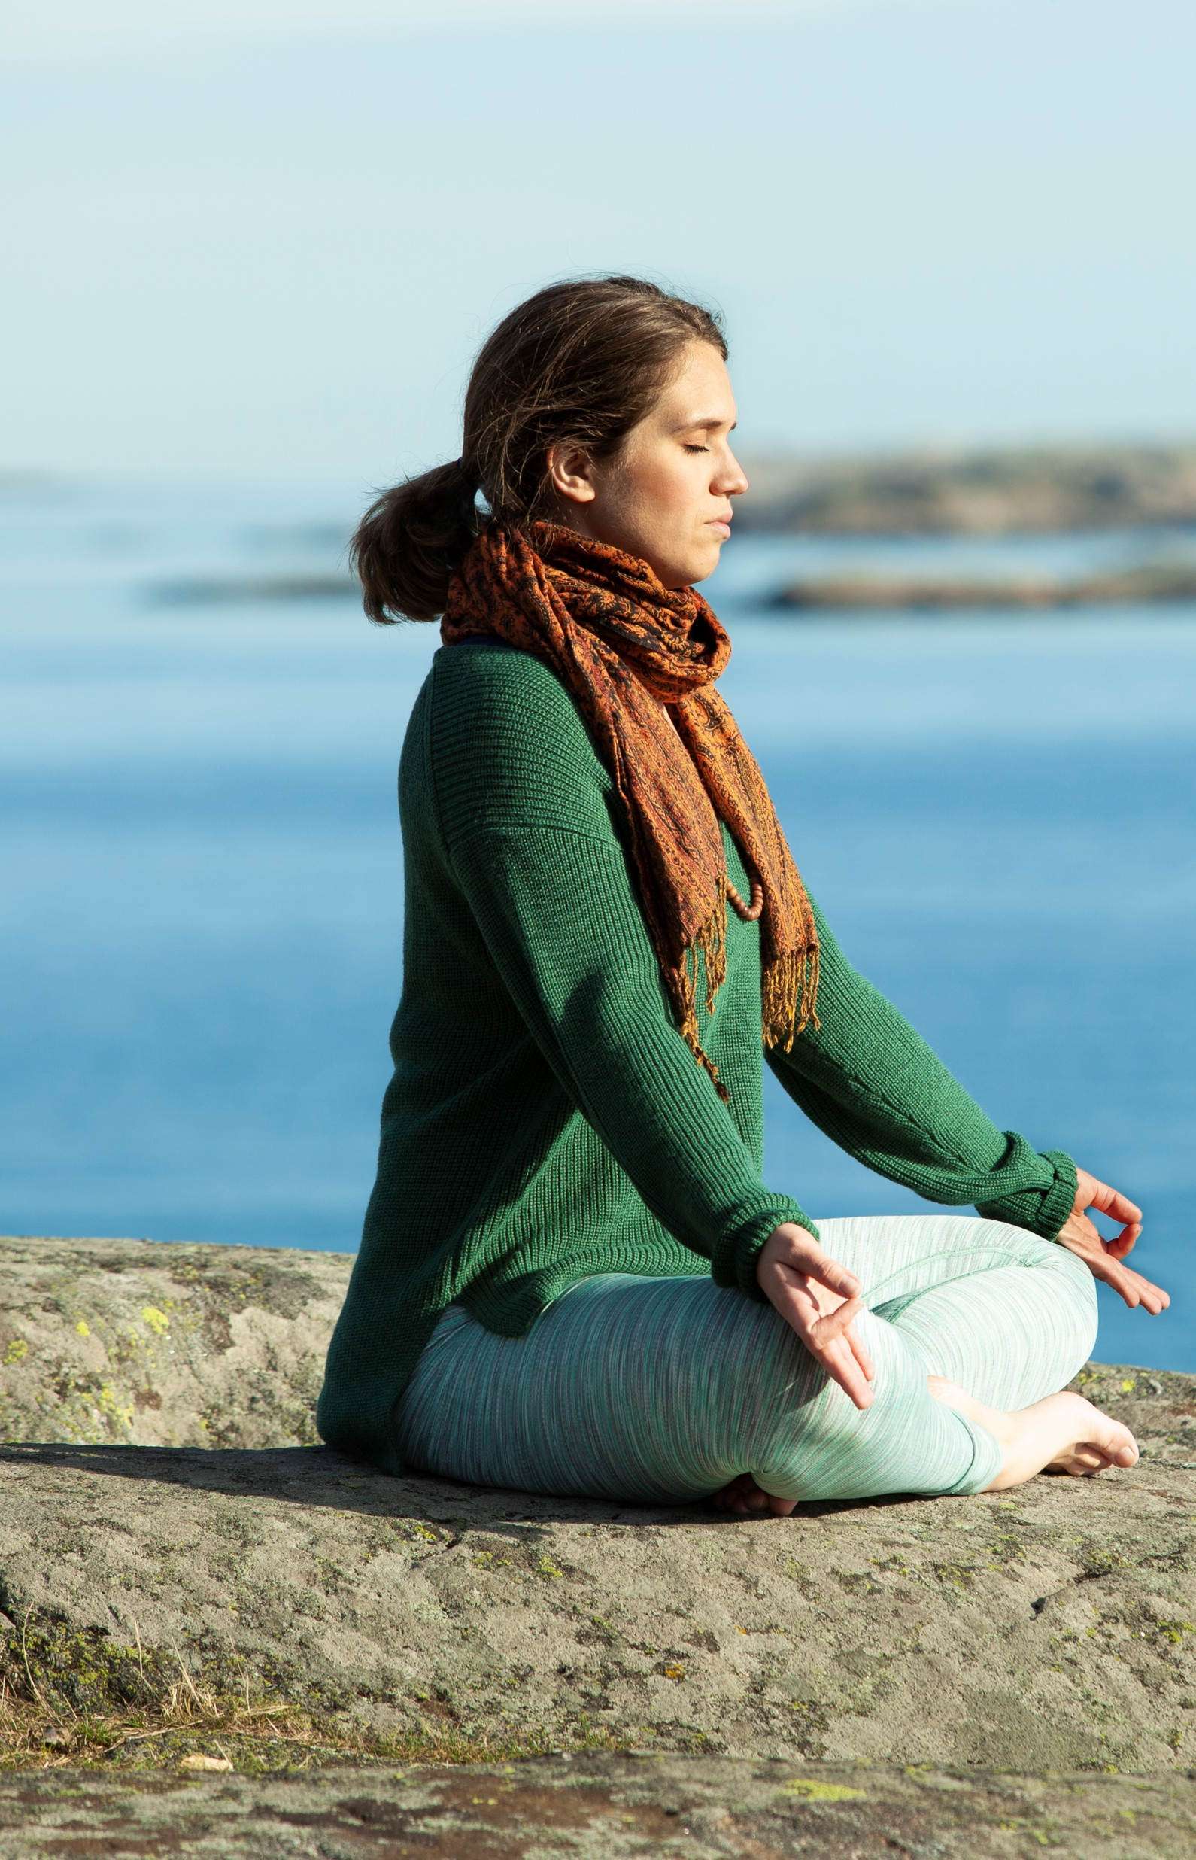
Pranayama
Life-force
Breathing

Slide 9
Meditation
Focus
Visualisation
Mantra
Breathing
Movement

Slide 10
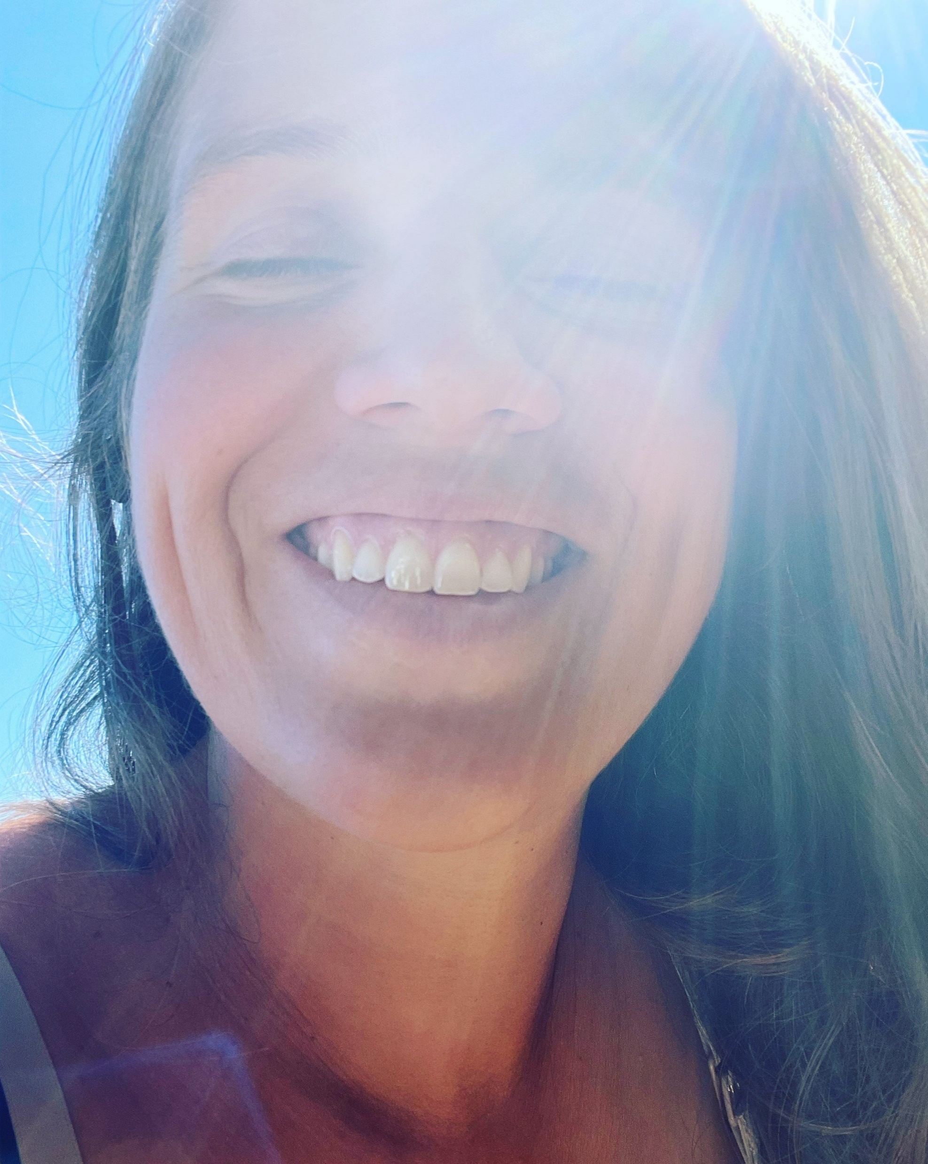
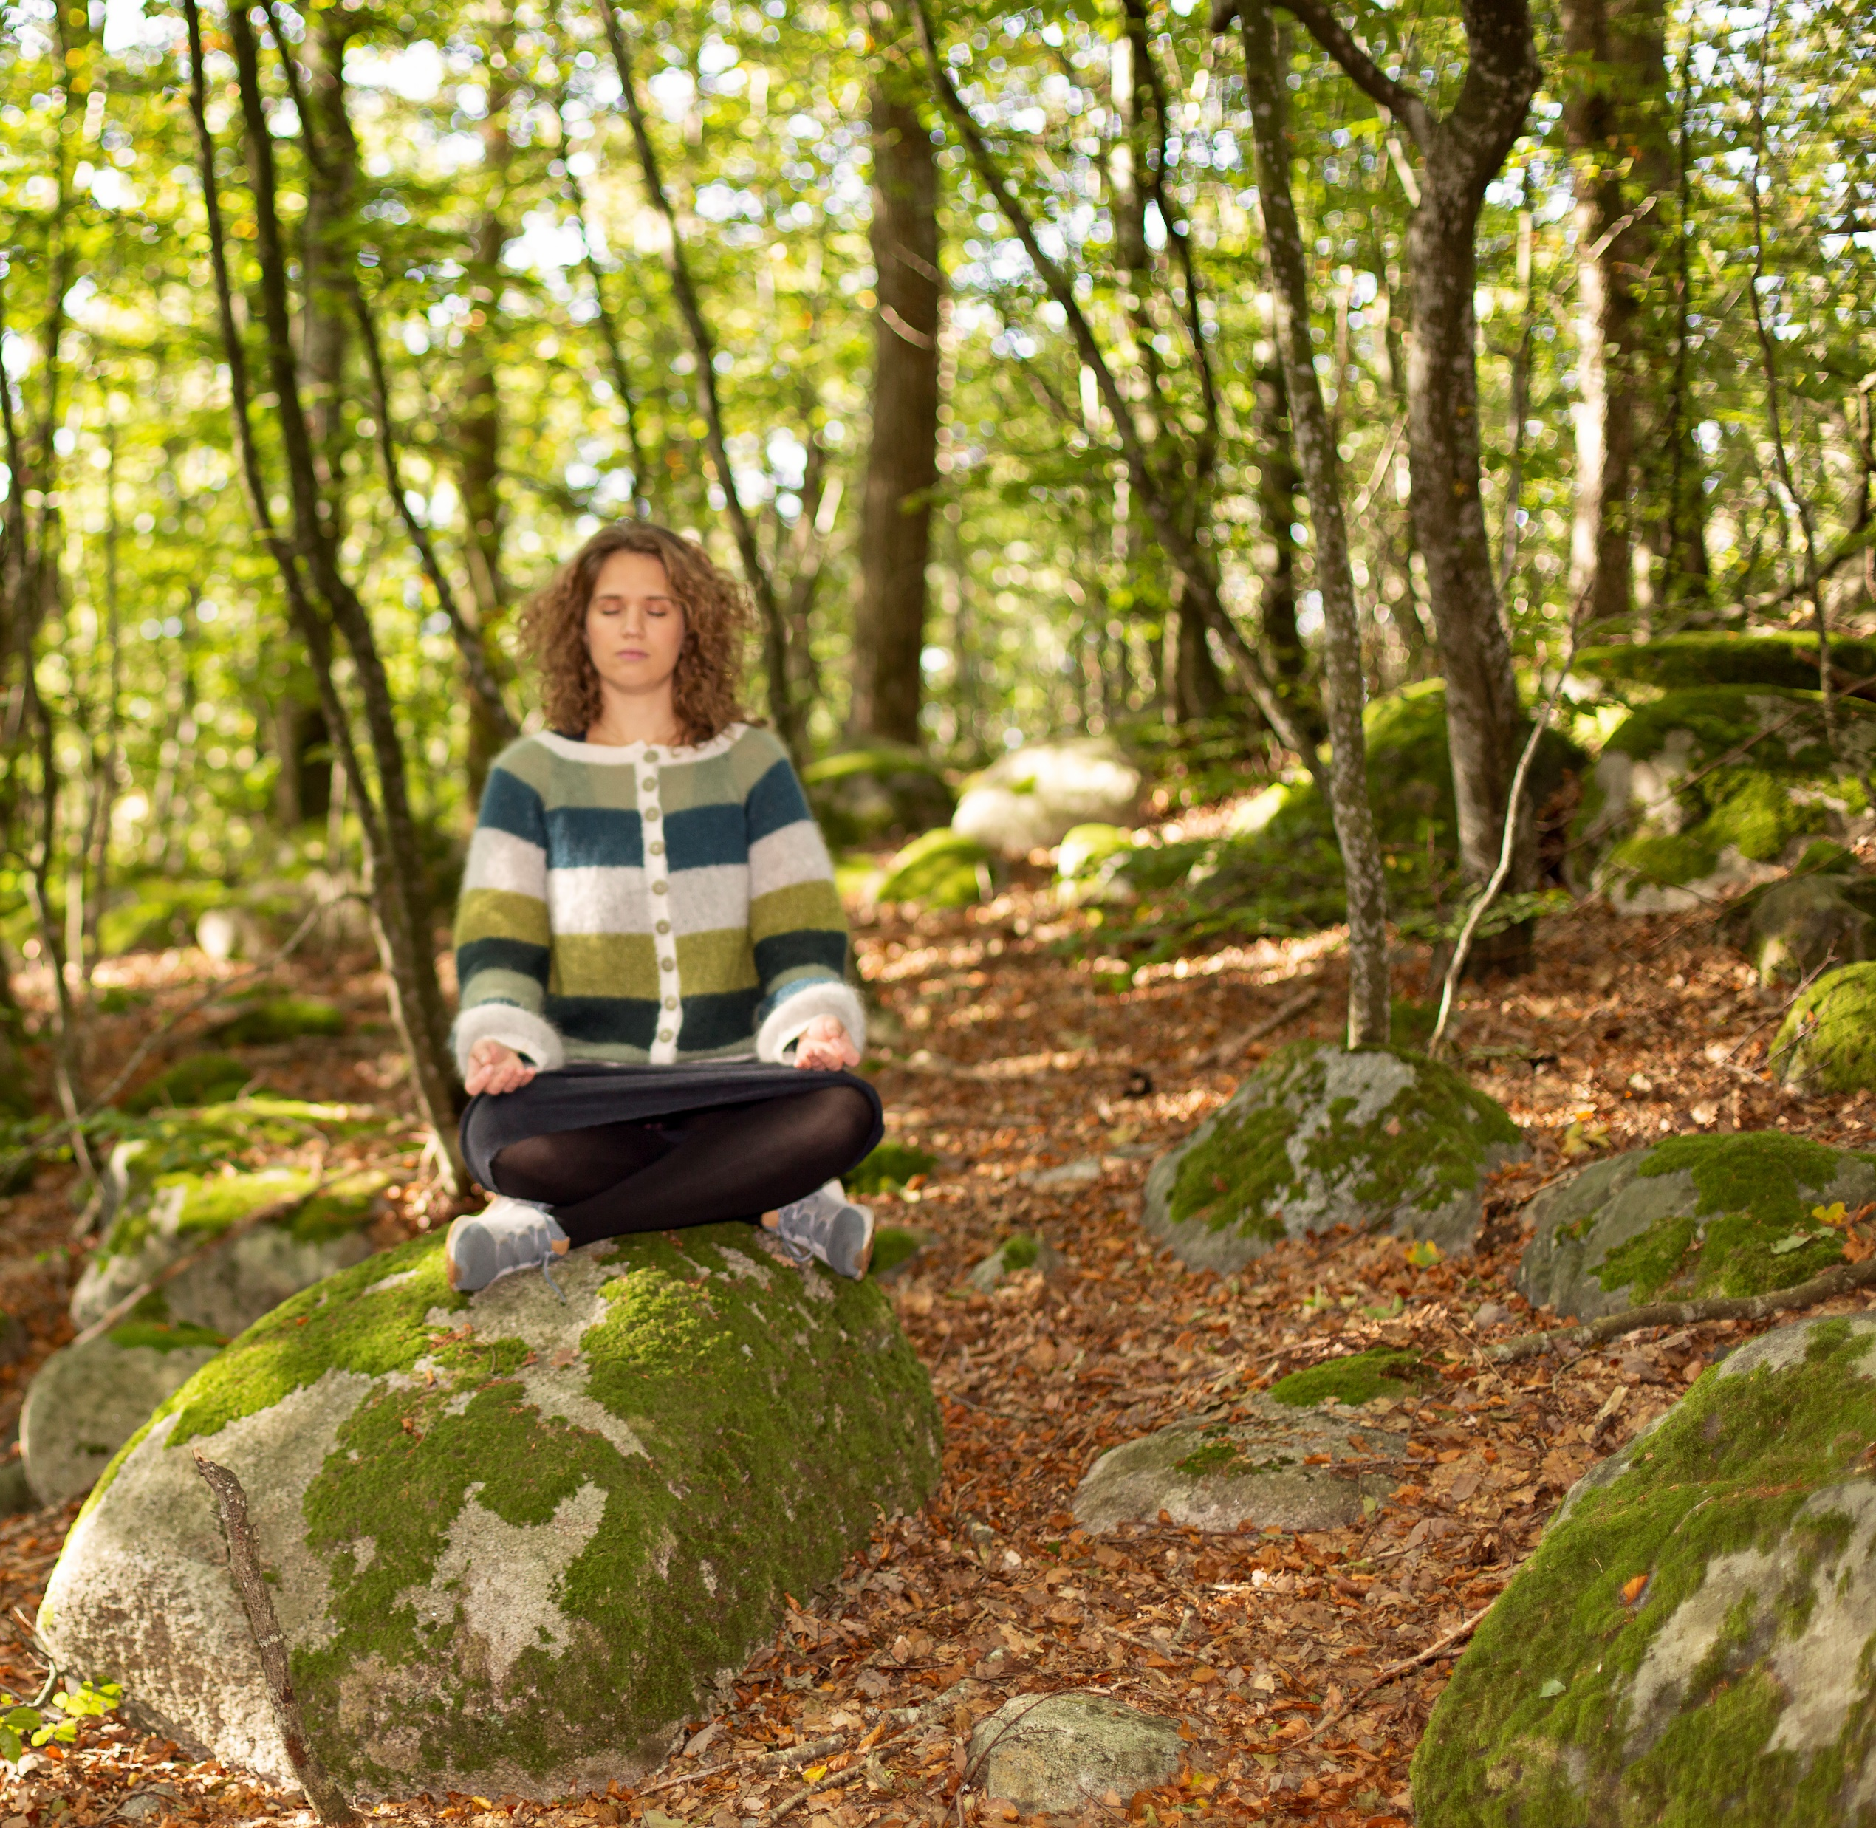
Remember that yoga is this:

Slide 11
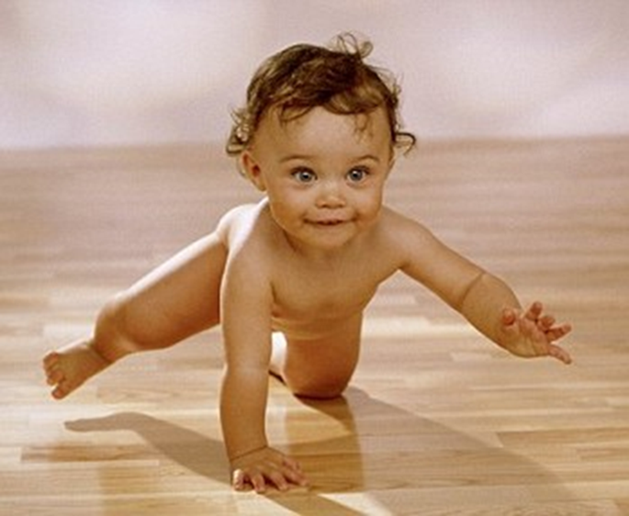

Slide 12
Yoga+ kinesiology=TRUE

Slide 13
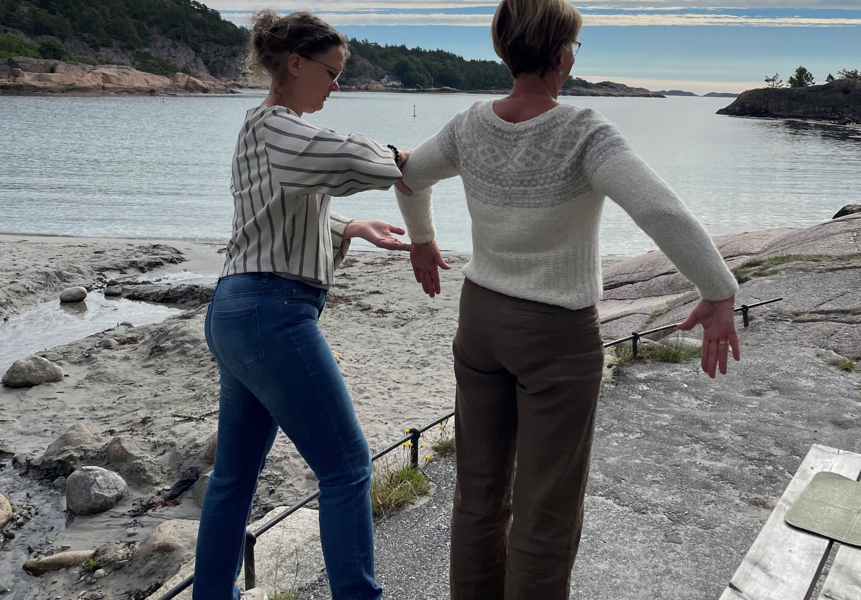
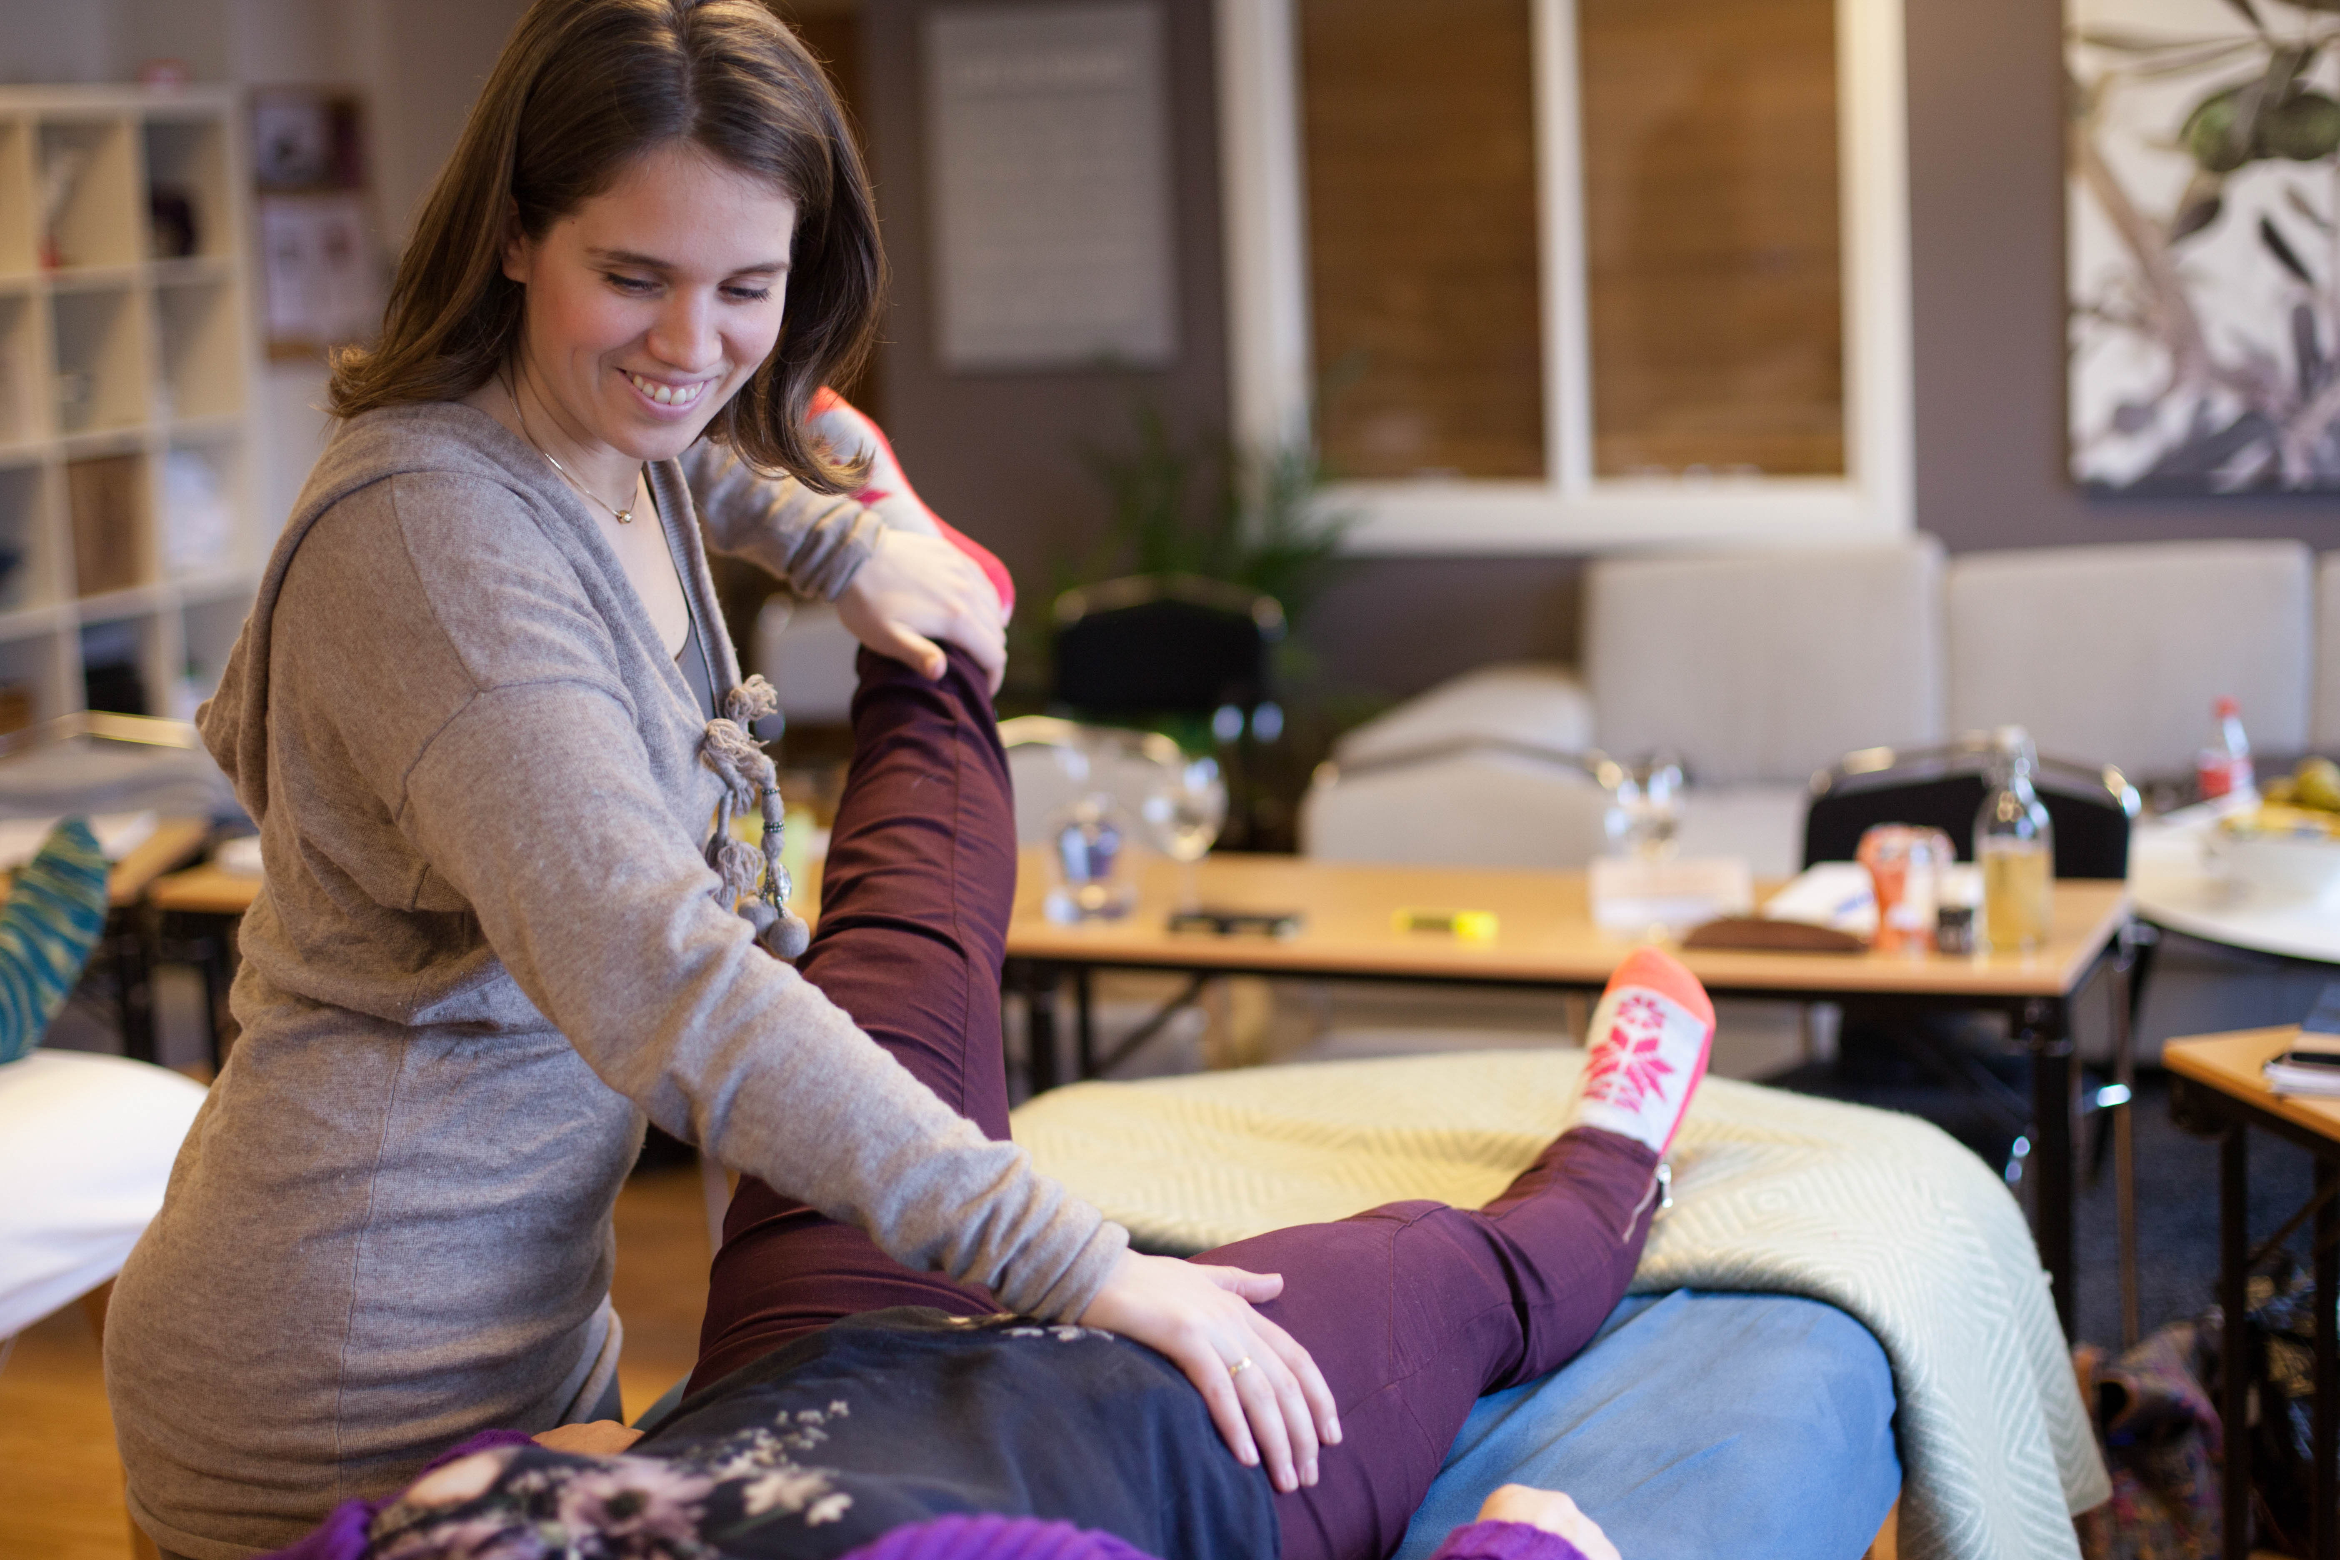
A starting point for a balance
Sit
Stand
Lay down
Active challenge

Slide 14
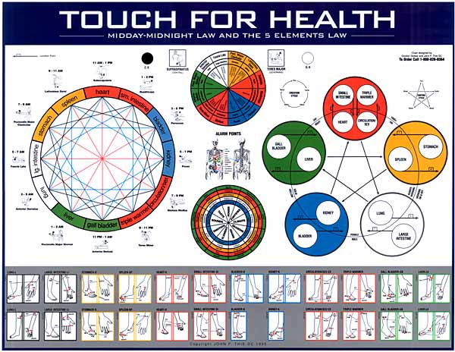
Yoga as a balance to 14 meridians

Slide 15
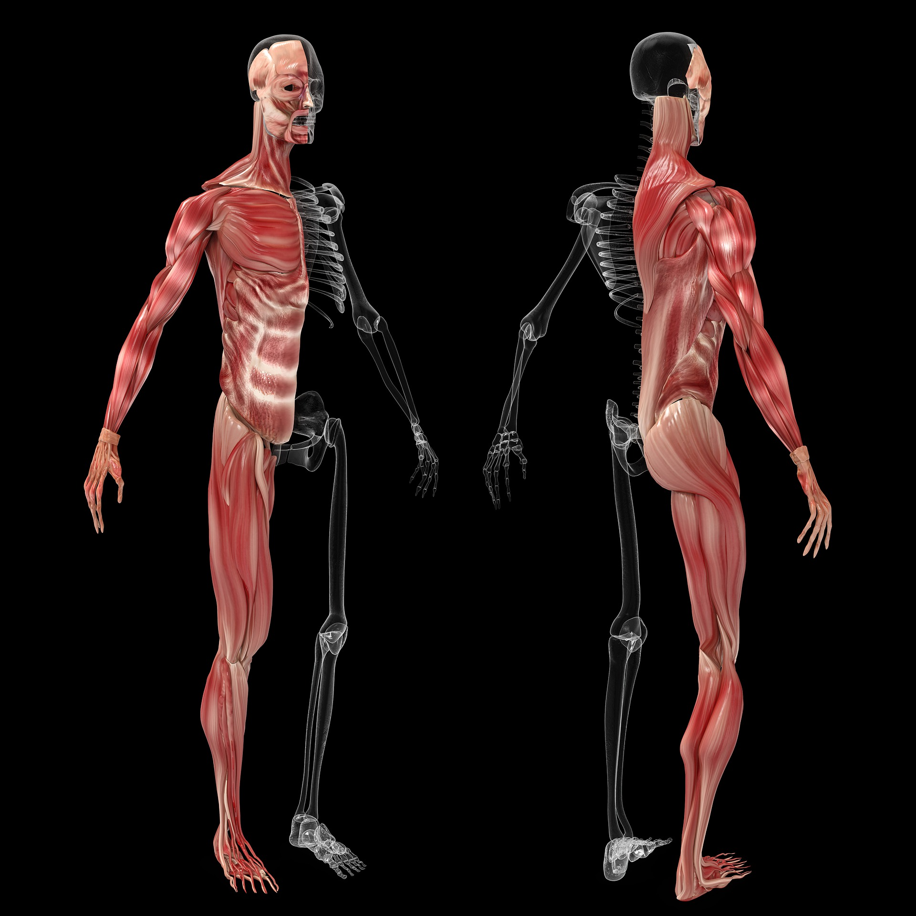
Yoga as a balance to 42 muscles

Slide 16
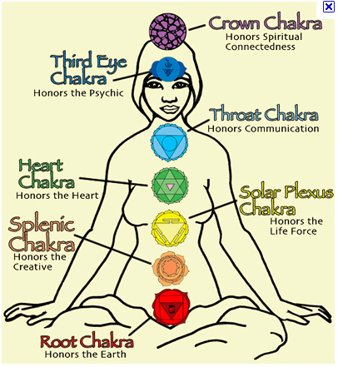
Yoga as a balance to chakras

Slide 17
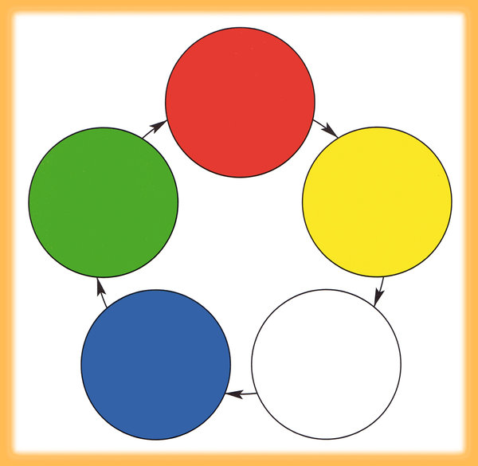
Yoga as a balance to 5-elements

Slide 18
Pranayama
Inhale, Exhale

Slide 19
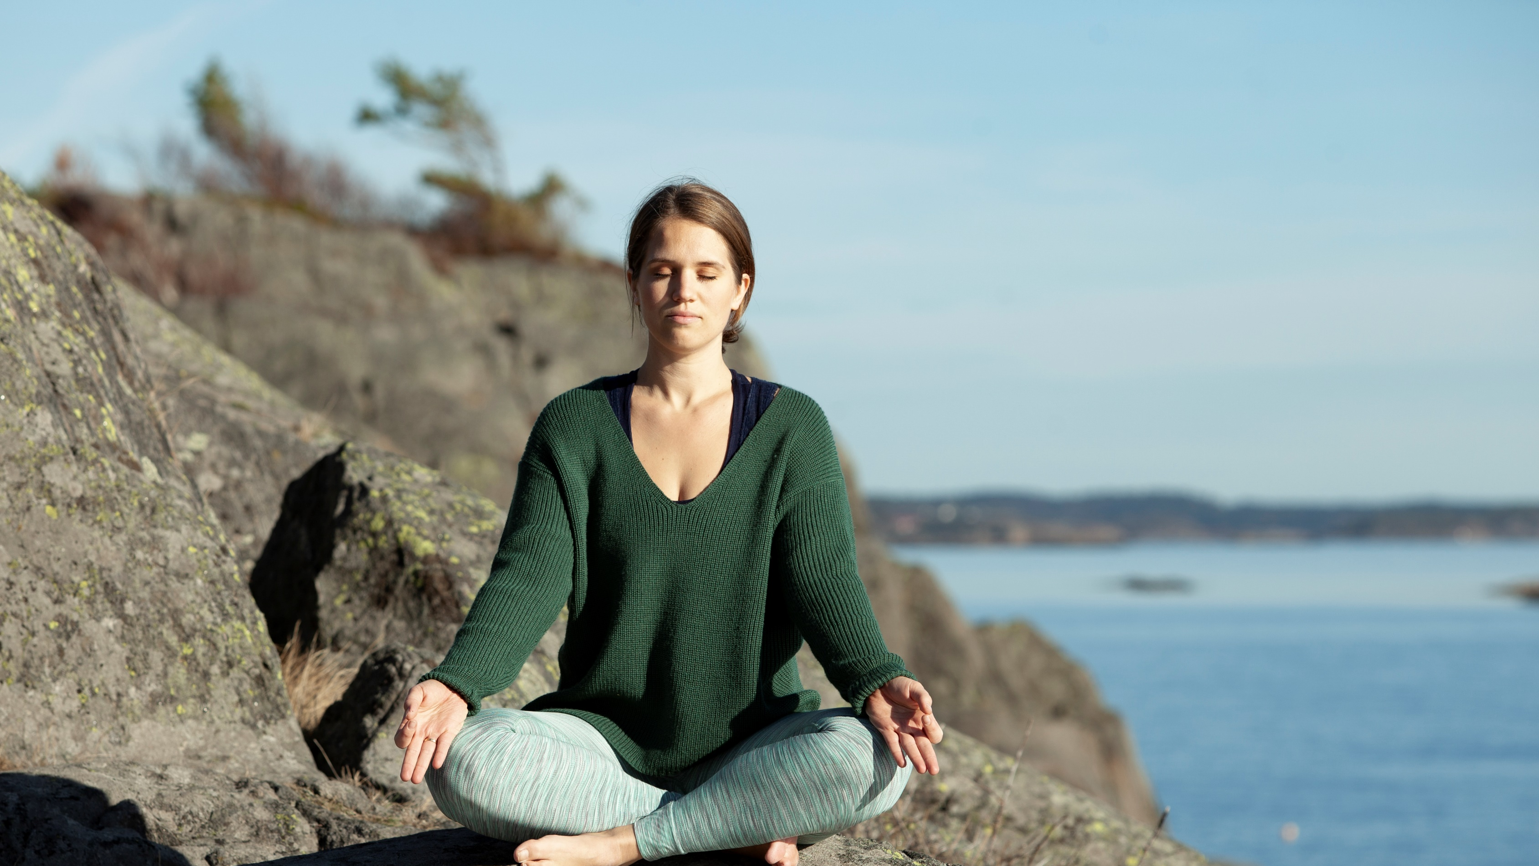
To breath in different areas of your body
Chest
Upper part of your stomach
Middle part of your stomach (navel)
Lower part of your stomach

Slide 20
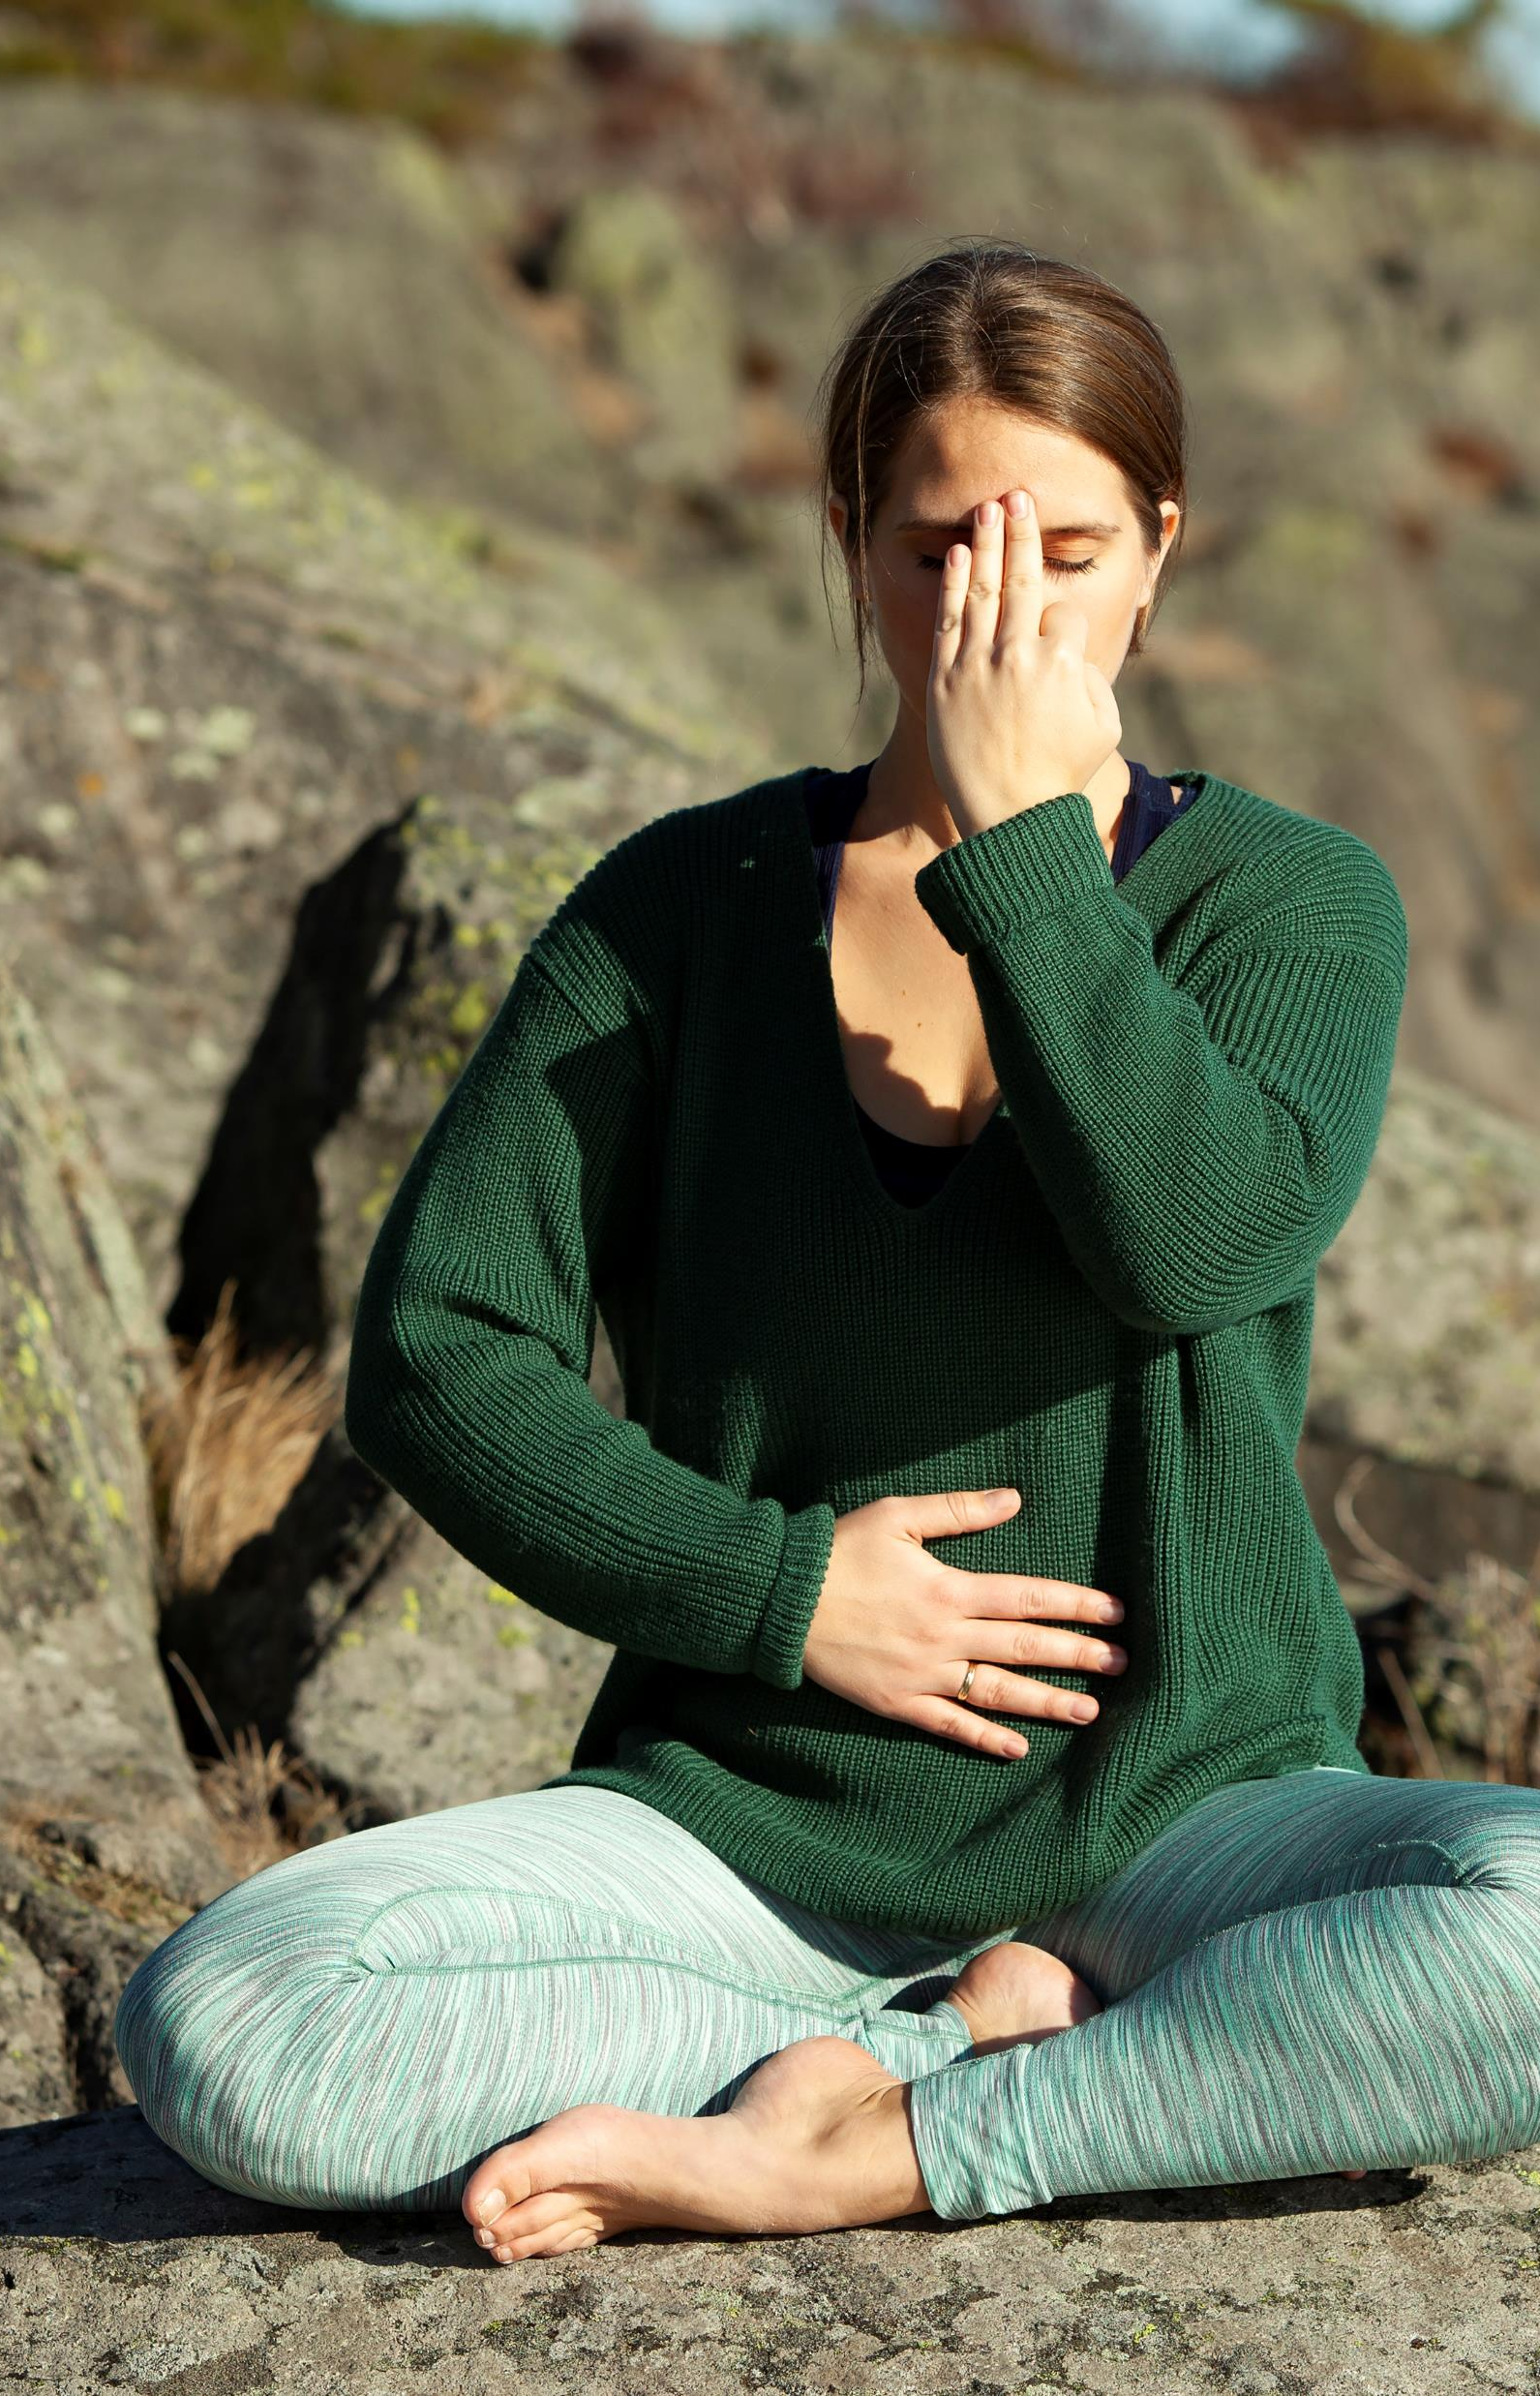
Different breathing methods:
Nose (nostril)
Mouth
Nadi shodana
in 4- out 4
In 4- out 8
4 steps breath
Breath of a wave
Breath of fire
Triangel /square

Slide 21
Working- factors:
Information
Circuit
Balancing

Slide 22
Post checks:
Supression
Timeframes
Secundary gain
Time deley respons
Integration
Trigger
Support

Slide 23
14 meridianer
Yoga asana to each meridian

Slide 24
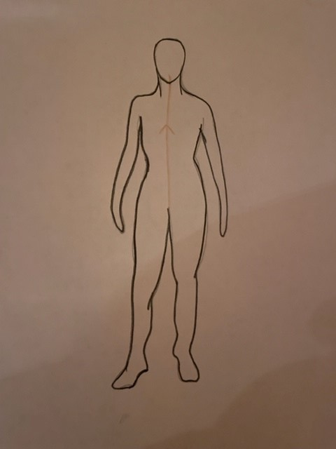
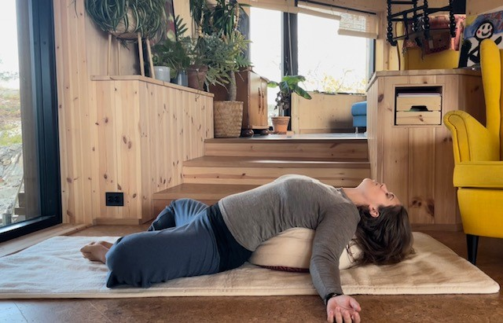
Central meridian
Supta Baddha Konasana
Chest opener

Slide 25
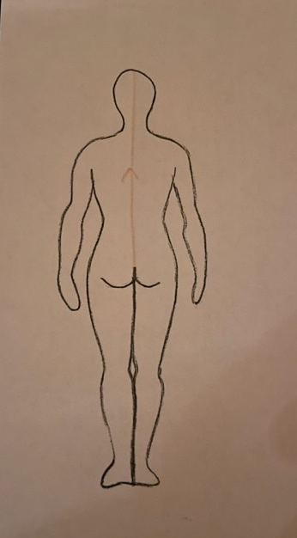
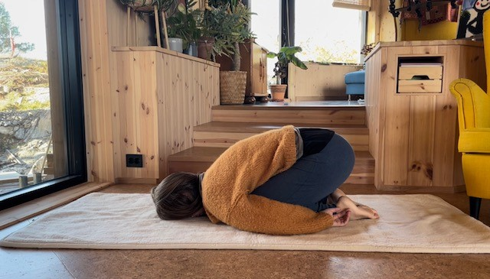
Governing meridian
Balasana
Child pose

Slide 26
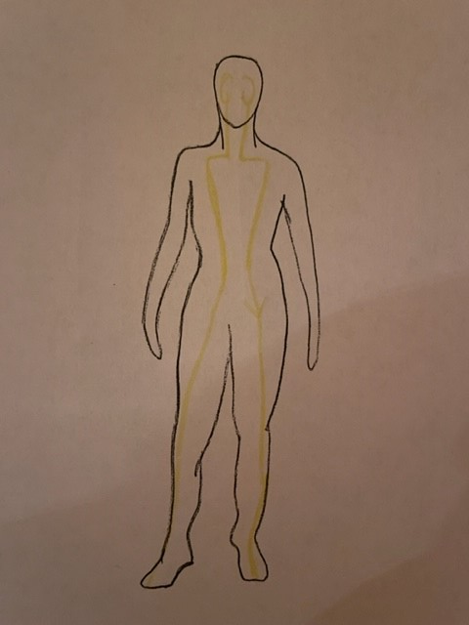
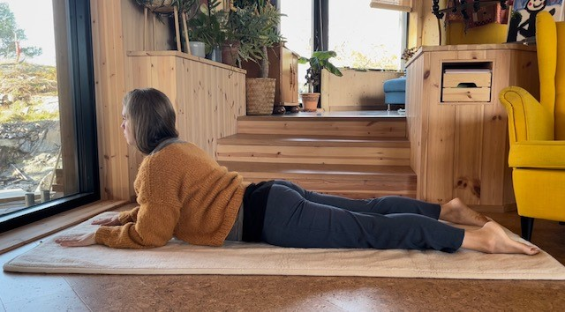
Stomach
Salamba Bhujangasana
Sphinx pose

Slide 27
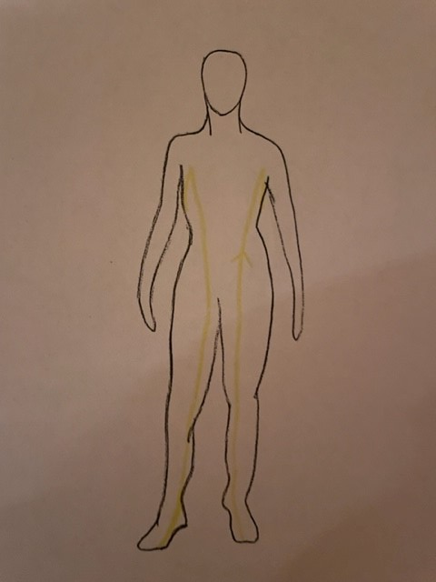
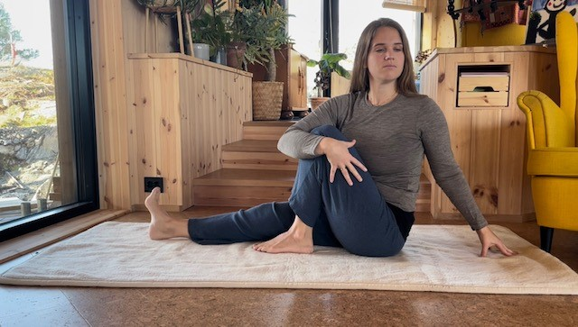
Spleen
Ardha Matsyendrasana
Sittende rotasjon

Slide 28
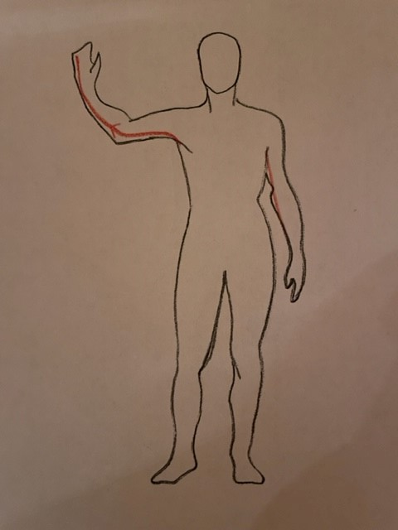
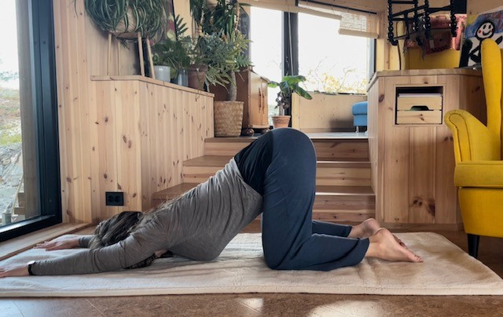
Heart
Uttana Shishosana
puppypose

Slide 29
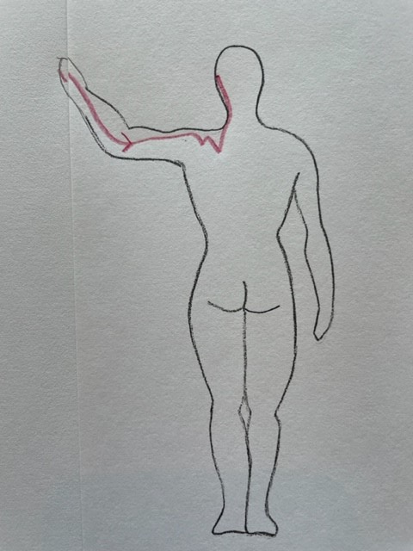
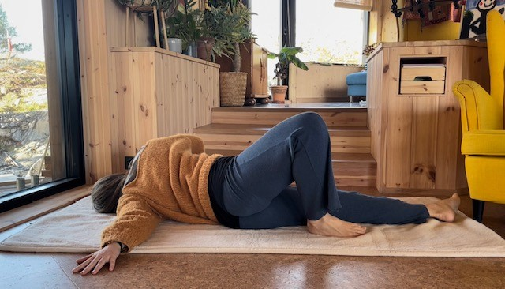
Small intestine
Opening wingpose

Slide 30
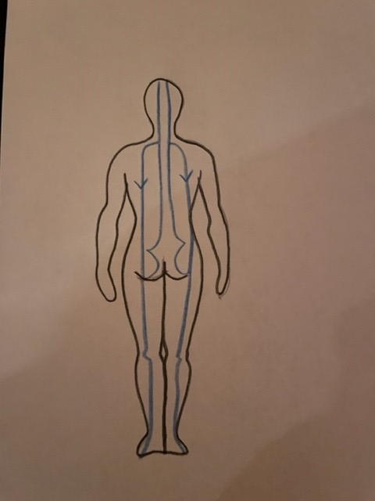
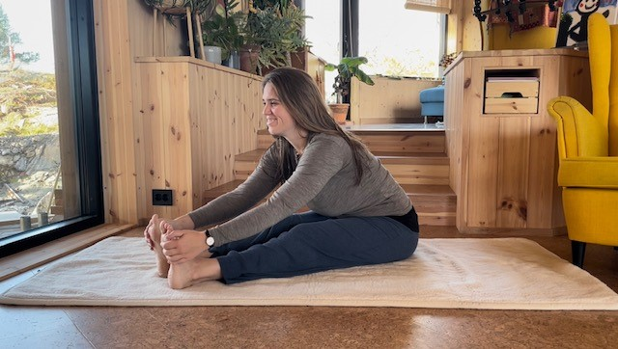
Bladder
Paschimottanasana
Forward bend

Slide 31
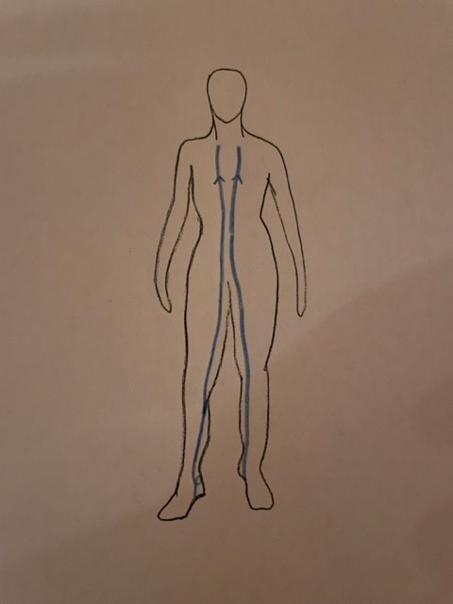
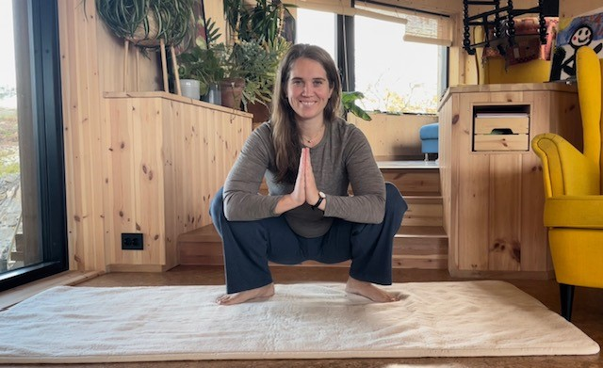
Kidney
Malasana
Squat pose

Slide 32
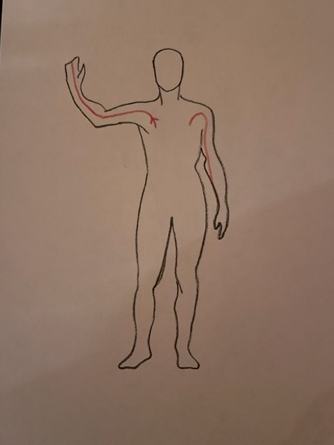
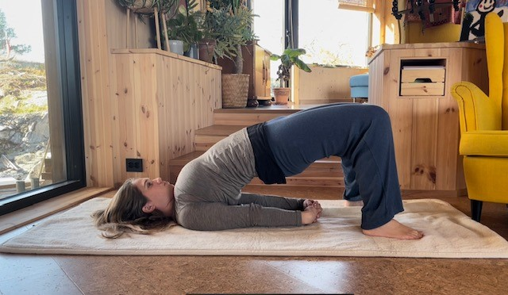
Circulation Sex
Setu Bandha Sarvangasana
Half bridge pose

Slide 33
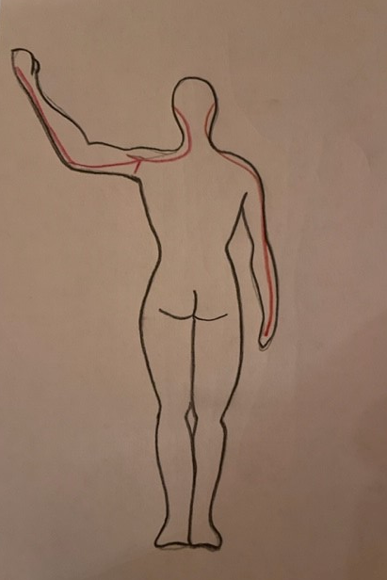
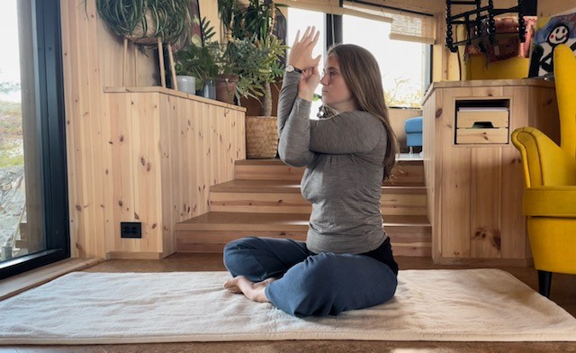
Trippel warmer
Garudasana
Eagle

Slide 34
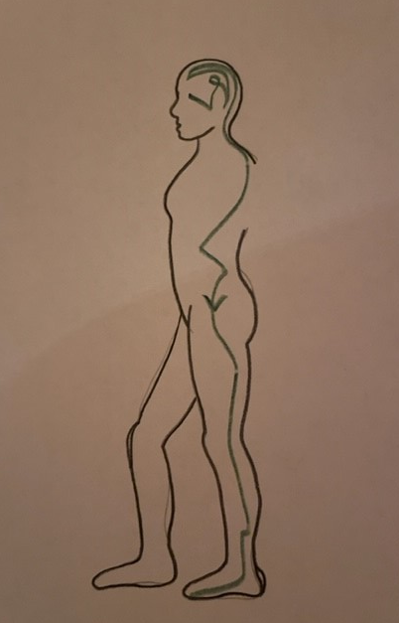
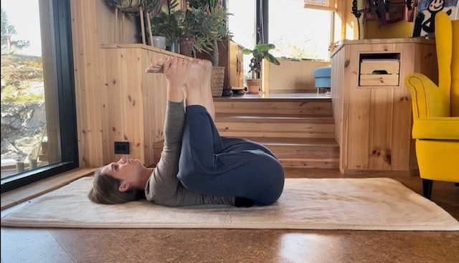
Gallbladder
Ananda Balasana
Happy baby pose

Slide 35
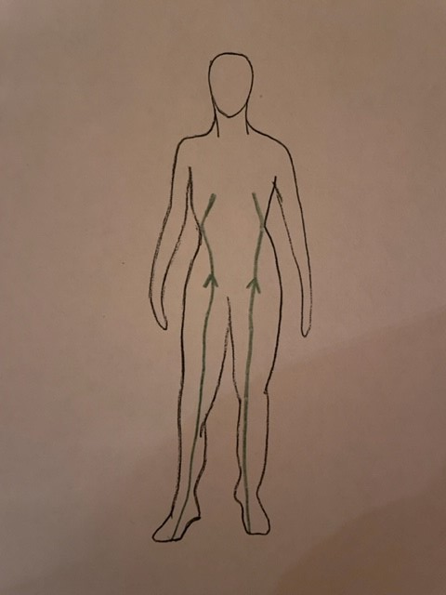
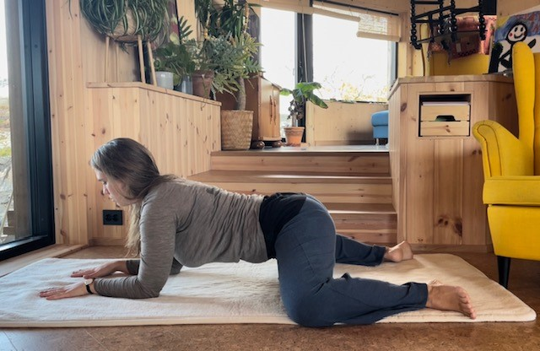
Liver
Bhekasana
Frogpose

Slide 36
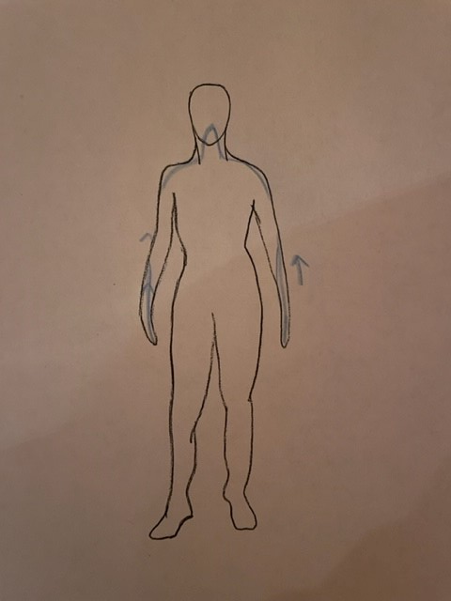
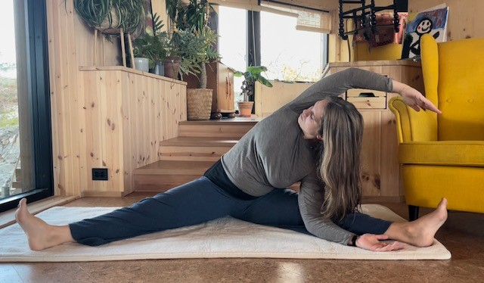
Lunge
Sidestretch

Slide 37
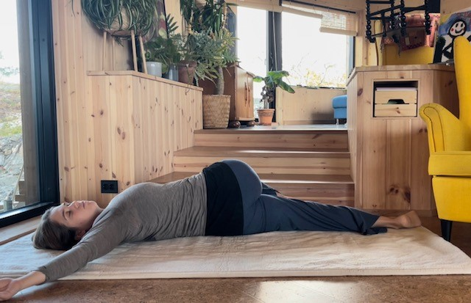
Large intestine
Shava Udarakarshanasana
Universal pose

Slide 38
namastè
www.dinberkana.no

Slide 39

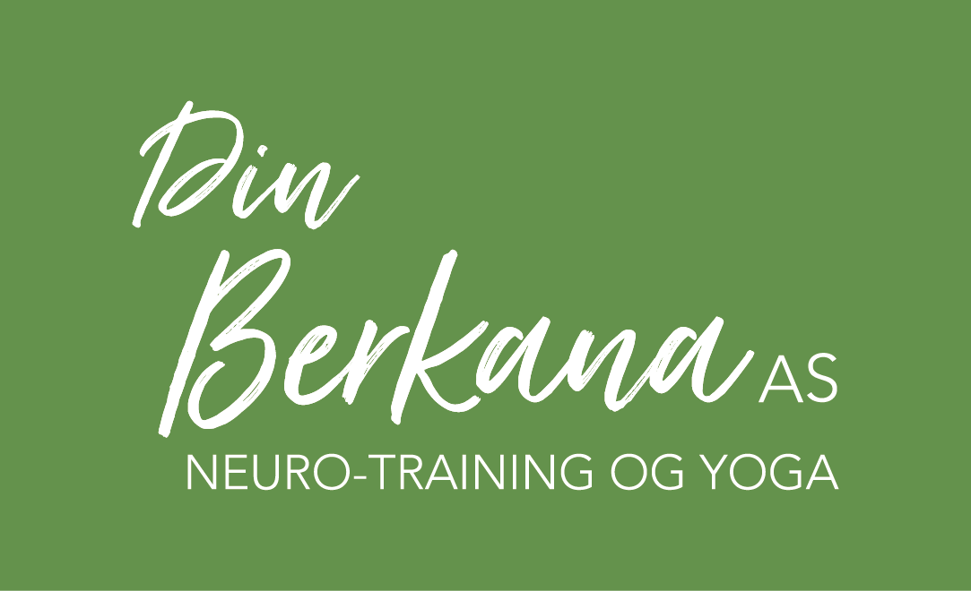
www.dinberkana.no
Malene Osa-Bjørkmo

