Slide 1
Spiritual Cycles
a program
derived from Vedic Science and literature
Dr.Rashida Naraharasetti

Slide 2
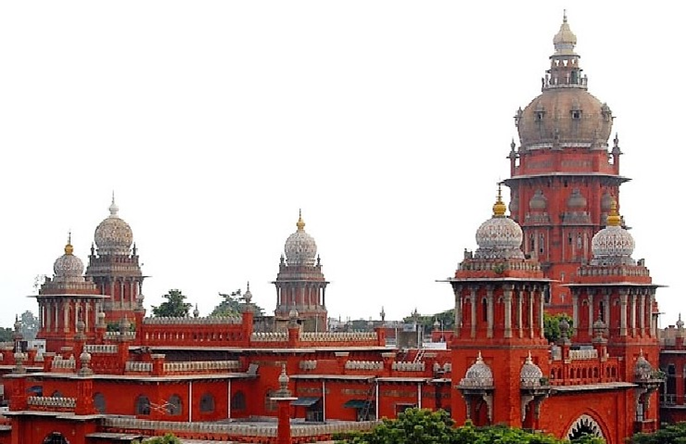
1964 Madras Law College

Slide 3
My Dreams and Transitions
Cycles in my life
1964 – age 6 - dreamed to become a lawyer
1974 - changed direction to become a doctor
1984 – Medical Internship

Slide 4
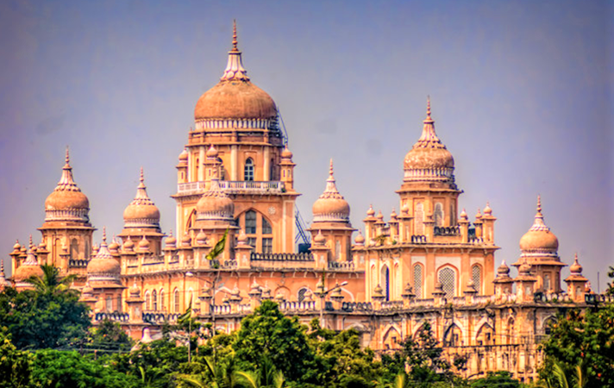
1964 Madras Law College 1984 Osmania Hospital Madras Hyderabad

Slide 5
Dreams and Transitions continued
1994 – Read about applied kinesiology- wanted to move into unlimited possibilities to wellness
2004 - TFH- Proficiency and TW
2014 – Brain Gym
2024 - ?????????

Slide 6




Dress codes transition Tools of the trade
Courtesy Google images

Slide 7
Topics covered in this presentation
Cycles in the macrocosm
Cycles in the microcosm
Parts of a Cycle - srusti-sthithi-laya
Intro to Spiritual cycles
5 layers of the body
3 bodies and their components
Spiritual cycle balance tips
Generic Correction techniques
Anchoring technique

Slide 8
Life is Dynamic and it follows a Divine order

Slide 9
Cycles and Rhythms
There are countless cycles and rhythms
in the universe
Macrocosm

Slide 10
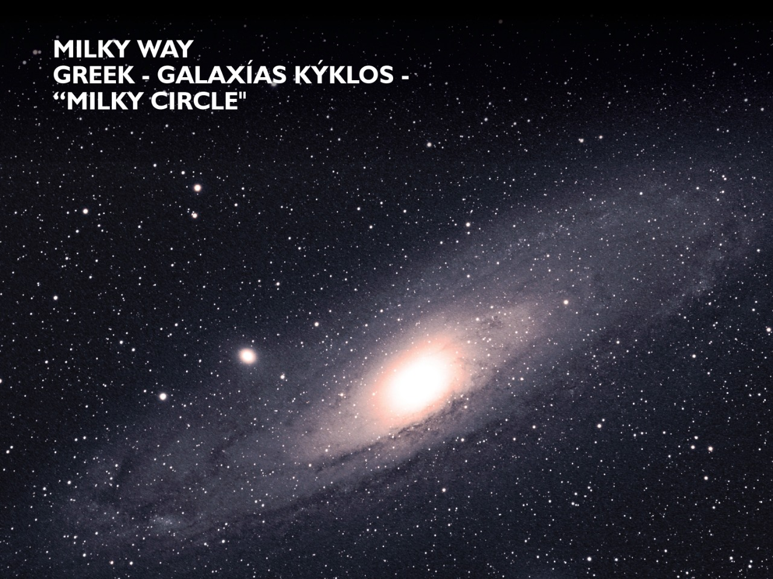
The space

Slide 11
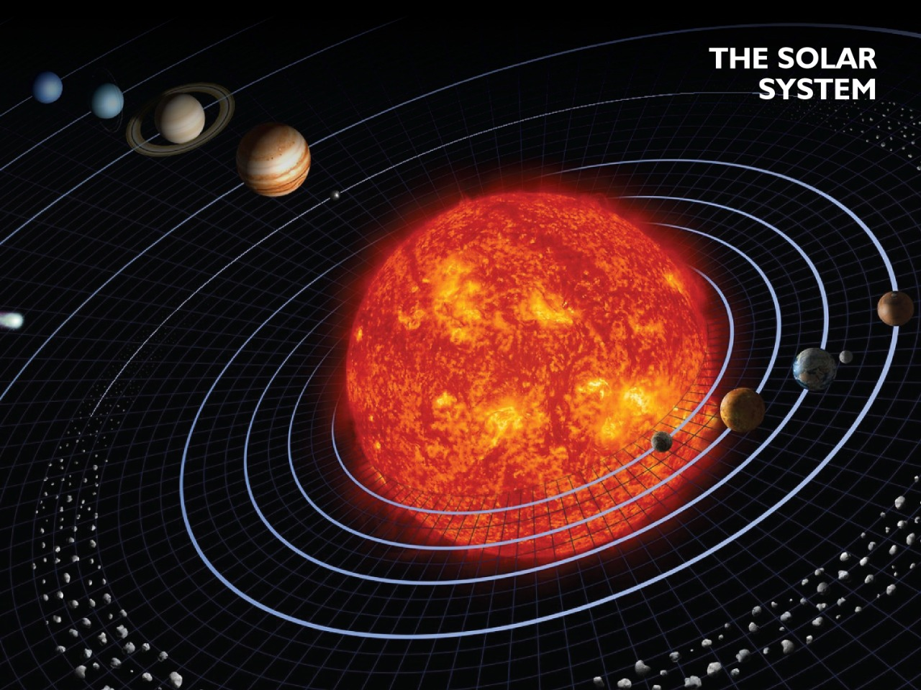
The solar system

Slide 12
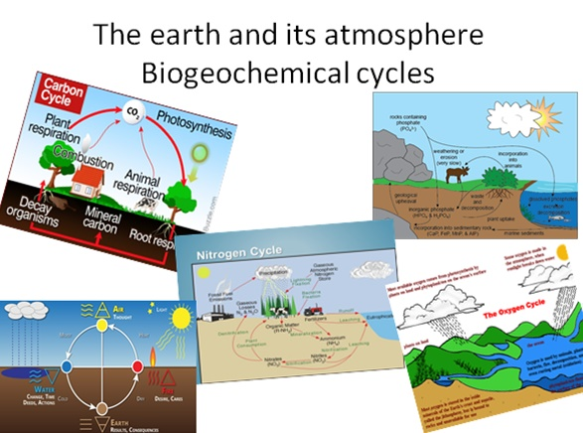
The earth and its atmosphere Biogeochemical cycles

Slide 13
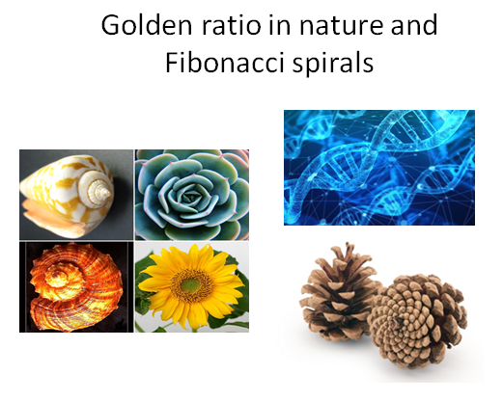

Slide 14
Most of these natural cycles balance and
regulate Earth and its atmosphere.

Slide 15
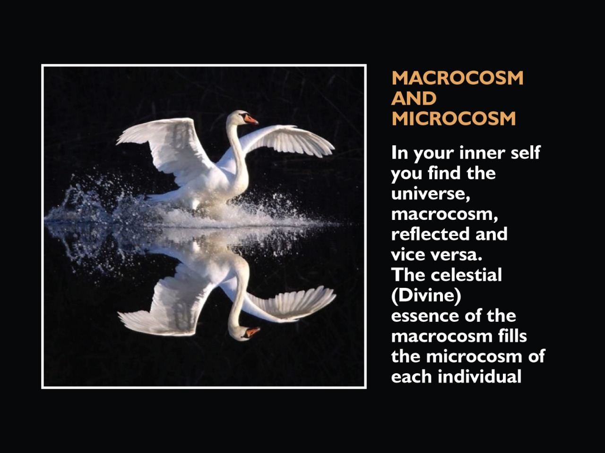

Slide 16
“Tat Tvam Asi” (Sanskrit), Thou art that, meaning ” the self in its primordial state is identical with the origin of all phenomenon.” ~ Chandogya Upanishad 6:8:7 ; 8th century BC
“This world is indeed a living being endowed with a soul and intelligence … A single visible living entity containing all other living entities, which by their nature are all related.” ~ Plato, Timaeus, 29/30; 4th century BC

Slide 17
Cycles within the cycle of life
Microcosm

Slide 18
Cycles within the Cycle of Life
Rhythm of breath
24 hour cycle, Day/Night Cycle, Circadian rhythm
Lunar Cycle
7 year growth cycle
Procreation cycles
Gestation cycle
Metabolic Cycles
Psychology
Atom

Slide 19
These cycles always follow an order following time and space.
Anything that is out of the order is a special experience.

Slide 20
By harmonizing energies through
Spiritual Cycle balance,
we attempt to restore harmony between
the microcosm and the macrocosm

Slide 21
Parts of a cycle

Slide 22
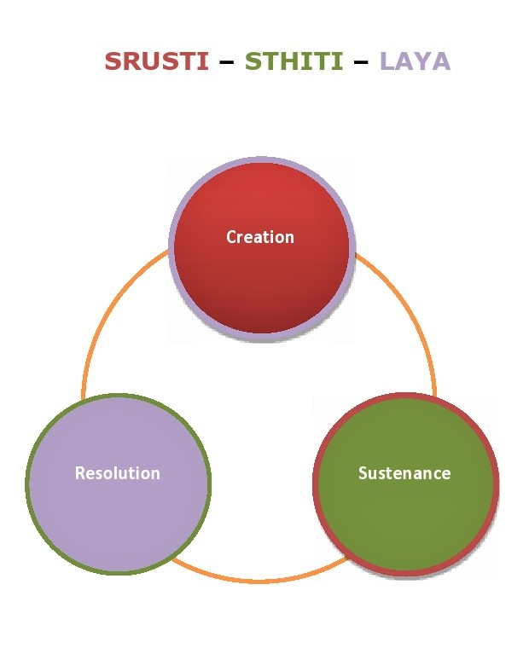
Parts of a cycle

Slide 23
Srusti/Creation
Is the energy converting into matter.
The pattern and form of what is created, the attributes of the body and the attitudes of the mind and the events that are created are aligned with the energy it carries.
The creation of physical matter is a magnificent manifestation of spirit- Srusti

Slide 24
Sthiti/Sustenance/Maintenance
Sustenance of the created matter
in various states, position, permanence, or continued existence in any place, and modes of motion.
The essence of every celestial body pulsates in every cell of the being through time and space.
Experiencing these pulsations with pure joy is Sthiti

Slide 25
Laya/ Resolution (Rhythm)
Spiritual freedom is an ever evolving process.
Thoughts, desires, ambitions and emotions are tools to experience this sense of freedom for spiritual awakening
Skillful use of the tools and attaining freedom is Laya
Is the revival of energy through matter converting into energy.

Slide 26
The spirit maintains its relationship with the matter while uncovering and discovering its true power through each experience.

Slide 27
Spiritual Cycles Balance

Slide 28
Spiritual cycles are cycles through time and space where the created matter experiences the consequences of its thoughts, words and deeds as it transcends into a wiser being towards Enlightenment/Nirvana.
According to Advaita Vedanta, these are beginning-less and endless cycles.

Slide 29
Some areas from
the Vedic literature that are applied in
the “Spiritual Cycle Balance®” Procedure

Slide 30
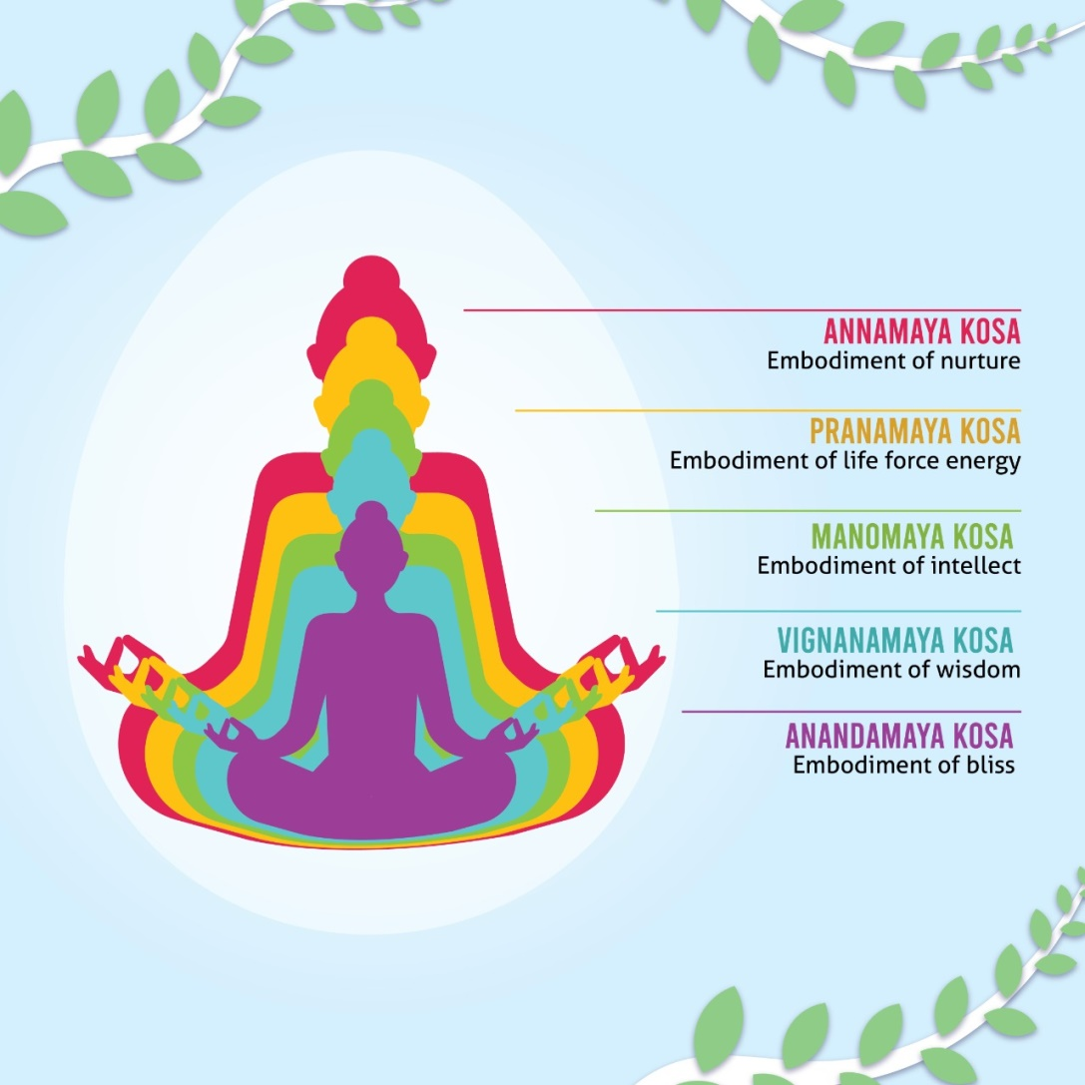
The Five Layers of the body

Slide 31
The Five Layers of the body
1st and the outer most layer - Embodiment of nurture
2nd layer - Embodiment of life force energy
3rd layer - Embodiment of intellect
4th layer - Embodiment of wisdom
5th and inner most layer - Embodiment of bliss

Slide 32
3 Bodies
The Gross or Physical body
Contains the 1st, outermost layer - Nurture
The Subtle or Astral body
Contains the 2nd, 3rd, & 4th layers – Energy, Intellect & Wisdom
The Causal body
Contains the 5th innermost layer - Bliss

Slide 33
Components of the gross body
5 primordial elements in their gross form
7 tissues
16 channels of transportation

Slide 34
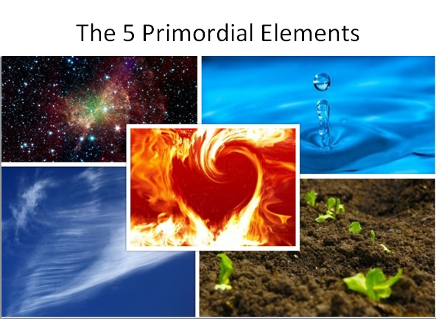

Slide 35
The components of Subtle body
5 Organs of sensory perception
5 Organs of action
Subtle essences of 5 elements
5 Prana
5 Vaayu
5 states of mind
4 Inner causes
3 Guna
10 Nadi
12 Chakras
Kundalini

Slide 36
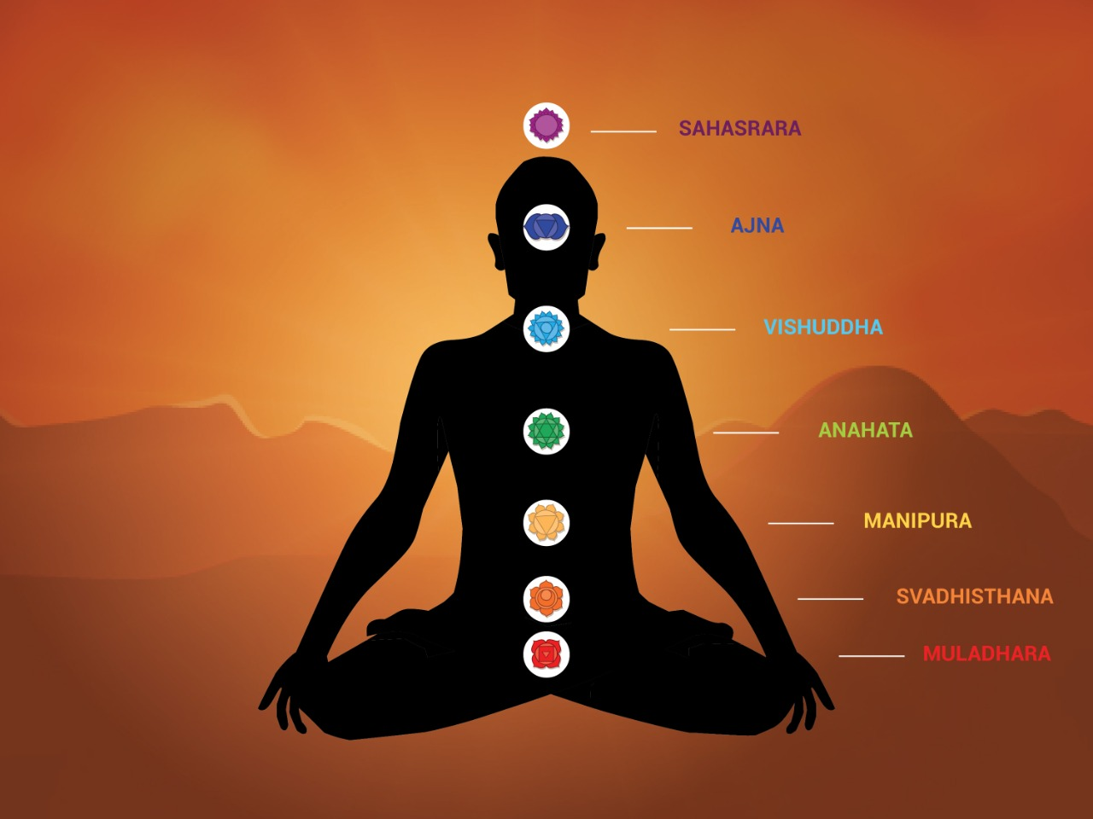

Slide 37
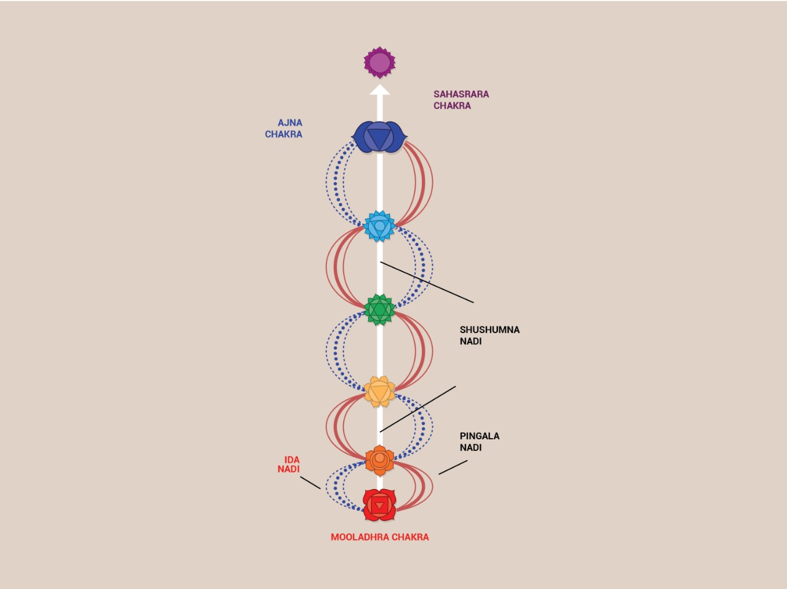

Slide 38
Element | Chakra | Organs of sensory perception | Organs of action | Subtle essences | Prana | Vaayu
Ether | Throat/ head | Ear | Mouth/ speech | Sound | Udana | Udana
Wind | Heart/ chest | Body/skin | Foot/moves | Touch | Prana | Prana
Fire | Solar plexus | Eye | Hands/carries fire | Form | Samana | Samana
Water | Sacral | Tongue | Anus/ urethra | Taste | Vyana | Vyana
Earth | Root | Nose | Sexual organs | Smell | Apana | Apana

Slide 39
The Components of Causal Body
Storage of information from past and present lives
Portal to entering cosmic consciousness as the concepts of time and space disappear.
Attitude as a detached observer who witnesses the matter from a different plane.

Slide 40
Humans are multidimensional beings and when problems arise they usually show up on multiple levels.

Slide 41
Group balance

Slide 42
While the global goal is to encourage a smooth and balanced flow of the immortal spiral, we consider each cycle separately to enable the spirit to move towards its final destiny in the present life cycle

Slide 43
Preparation in a Spiritual Cycle balance
Awareness of your relationship with your spirit
What does Spirituality mean to You?
How close are you to your soul?

Slide 44
3 steps of Generic corrections
Step one - reconnecting to the original wisdom
Step two - allowing the flow of integrated wisdom
Step three - Trikarana sudhhi

Slide 45
Goal
Step 1 - Global goal -The soft focus is on spiritual cycle of the current life.
Step 2 - Specific goal - area of concern be it; gross body, subtle body or causal body that
the individual is consciously aware of.

Slide 46
Assessment and correction
Muscle test which of the 3 bodies and 5 layers is imbalanced
Muscle test to choose a correction from correction techniques

Slide 47
Correction techniques
Pranayama/breathing
Mudra – 32 most powerful Mudras
23 Basic Mantras
Nyasa - hand, body
Chakras – 12 chakras, 30 possible corrections in basic 7 chakras
Postures
Pratyahara
Marma

Slide 48
Anchoring
Being the witness exercise
Circumambulation
Affirmation - I am the Pure Blissful Consciousness

Slide 49
Noticing the changes
What does Spirituality mean to You?
How close are you to your soul?

Slide 50
Workshop Series

Slide 51
Spiritual cycles balance procedure
5 Elements intro
5 Prana and 5 Vayu - theory and corrections
Mudra – theory and applications
Mantra – theory and application
Nadi- theory and corrections
Chakra theory
Chakra balance
Kundalini meditation

Slide 52
Dr. Rashida Naraharasetti
rashida23@gmail.com
whatsapp +16472281405
www.drrashidan.com

